Slide 1
Thoracic Oncology- STR Teaching
Himali O’Regan

Slide 2
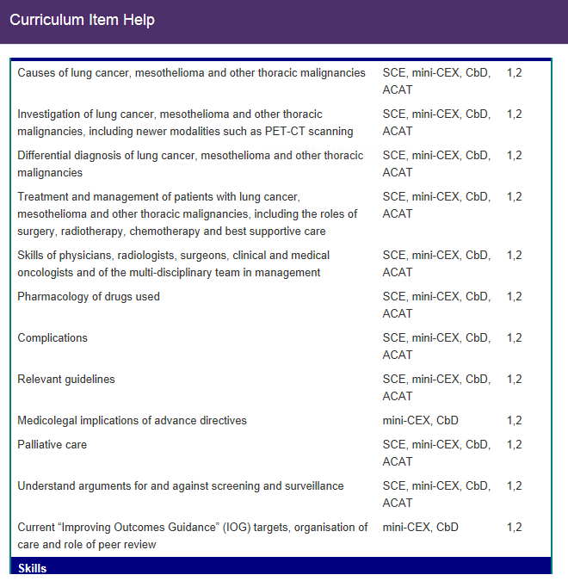

Slide 3


Slide 4
Need for change….
Leading cause of cancer death in UK
Poor 5 year survival rate (14% for males, 17.5% for females)
‘25 by 25’ initiative (UKLCC)
Variances in care depending on region/trust
Notes:
Surgery rates in all non-small cell lung cancer (NSCLC)
(audit target 17%)
——18 organisations were identified as having better surgical resectation rates
than the national average, suggesting good practice
——However, adjusted surgical resection rates varied from 4.8% - 40.1%
Systemic anti-cancer treatment (SACT) rates in NSCLC
(stage IIIB/IV and performance status 0-1) (audit target 65%)
——Overall, 62% of patients with good performance status and advanced NSCLC
recieved SACT
——Excluding tertiary trusts, the casemix adjusted results varied from 25.7% to
100%
Curative intent treatment rates for stage I-II NSCLC
(performance status 0-2)
——Overall, 80.4% of patients with early stage disease and good perfomance
status recieved treatment with curative intent in 2016; however this means that
one in five such patients did not recieve treatment with curative intent, which is
not good enough
——Across individual organisations the rate of treatment with curative intent varied
from 54.5% to 100% (data from NLCA, UKLCC)

Slide 5
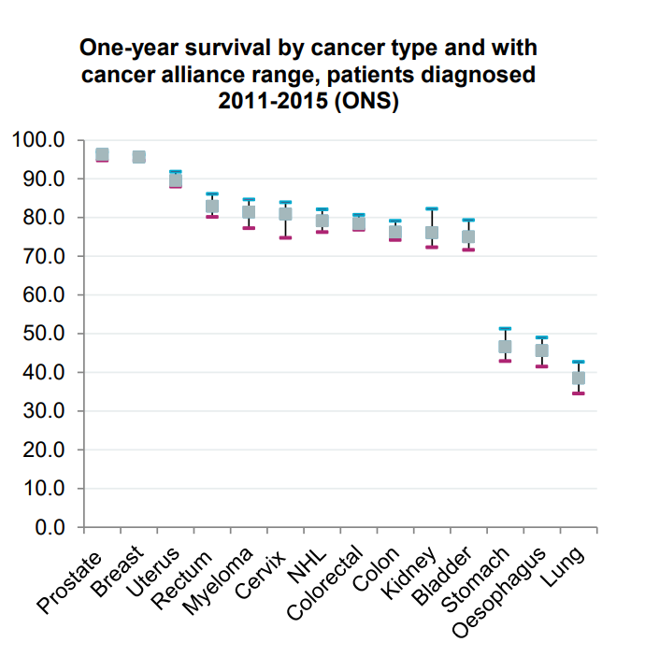
Lung cancer survival
Low lung cancer survival compared with other European countries
Five year survival of 15.2 % (for patients followed up to 2016
Lung cancer Tx, NHS England

Slide 6
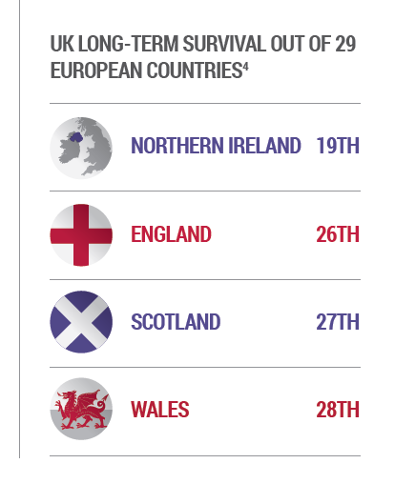
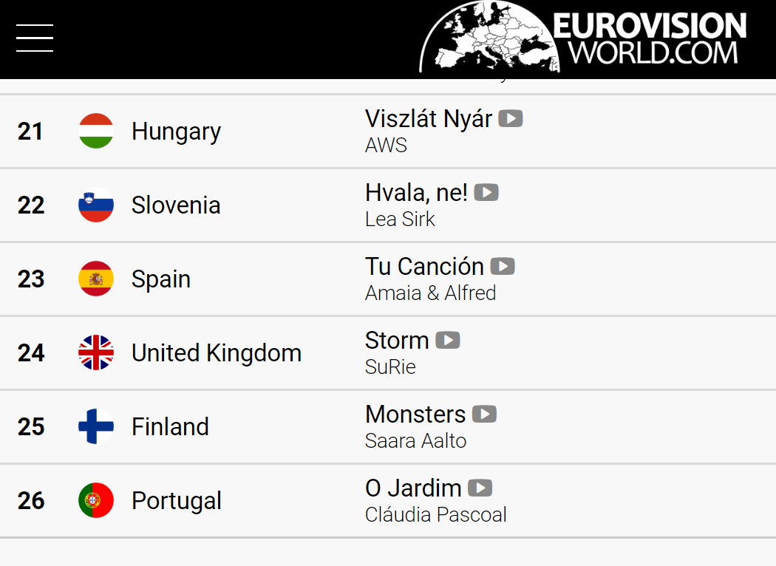
How we compare against our neighbours…

Slide 7
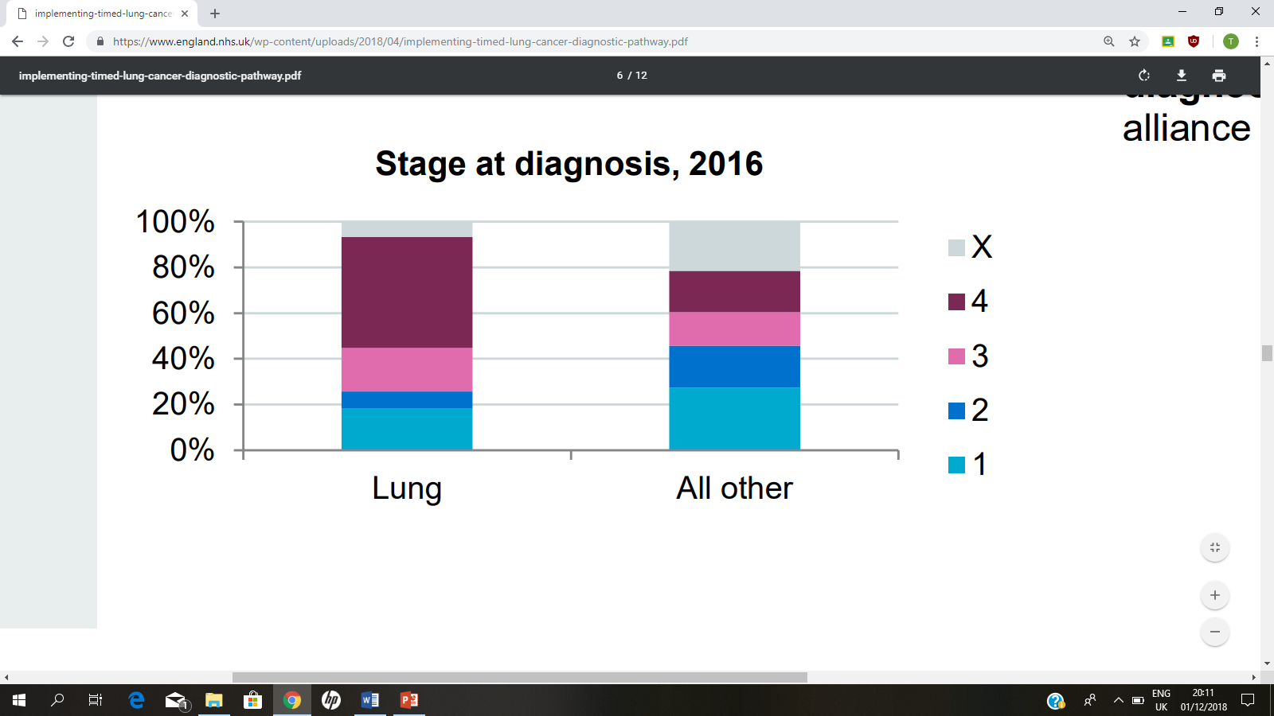
Stage at Diagnosis
Only 25.7% of lung cancer diagnosed at an early stage
NLCA, 2017

Slide 8
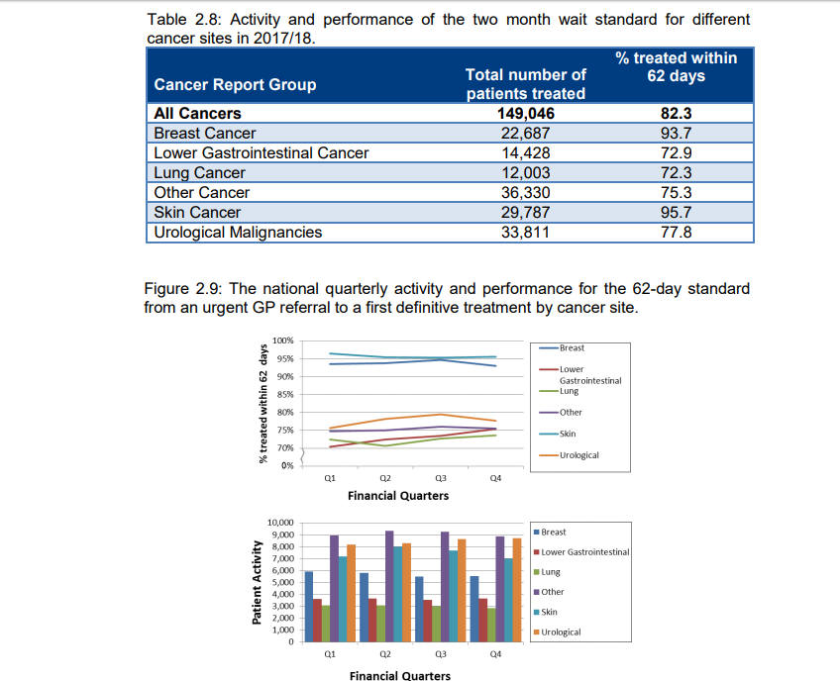

Slide 9
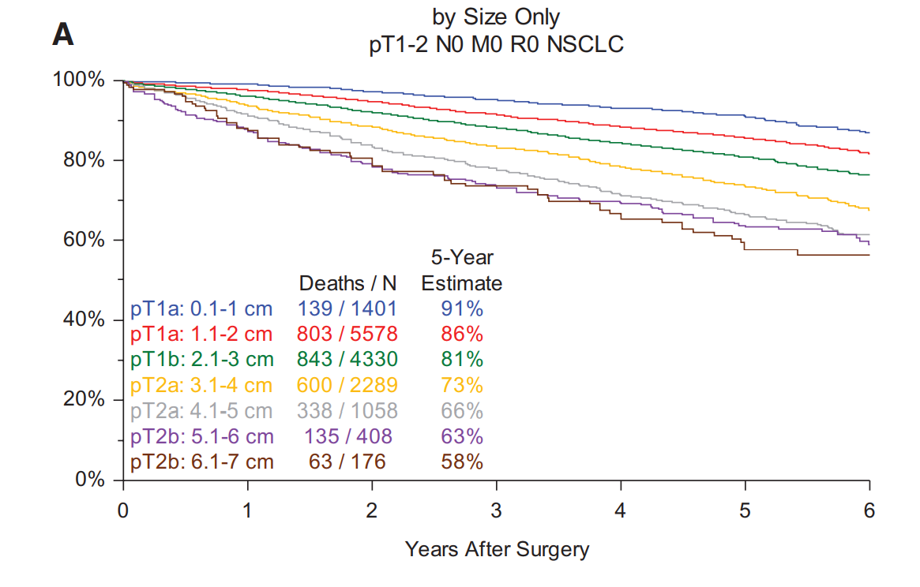
The IASLC Lung Cancer Staging Project (IASCL staging committee article)

Slide 10
How can we improve lung cancer survival?
Early diagnosis/early stage
Improved treatment options
Early treatment
=NOLCP!!!!
(National Optimal Lung Cancer Pathway)

Slide 11
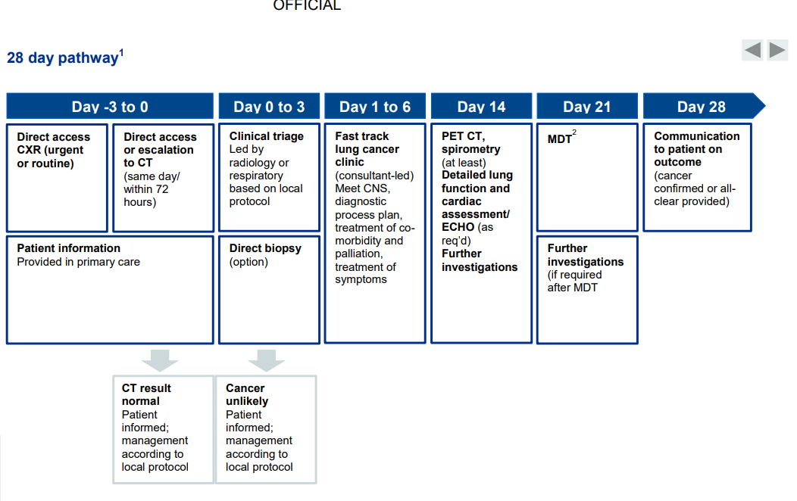

Slide 12
Aims of Pathway
Diagnosis or ruling out of cancer within 28 days.
More patient focused?
Decrease anxiety (26% of patients report deterioration in health while waiting for treatment decisions)

Slide 13
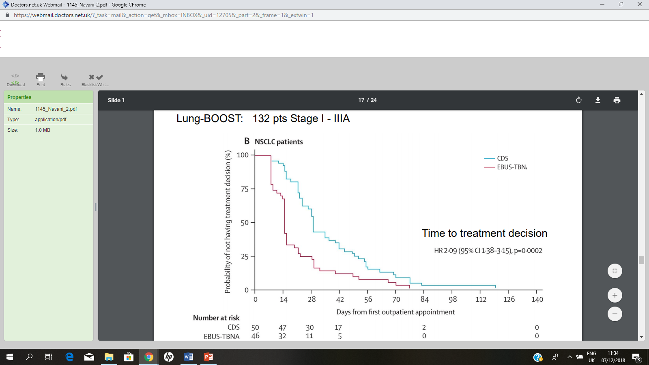
Does a faster pathway= better outcomes?
Lung – BOOST trial (2015)- Lung ca diagnosis and staging with EBUS vs conventional approaches
Shorter time for EBUS patients to get treatment decision (14 days vs 29 days for conventional diagnostics group)
Cost the same
Fewer tests in EBUS group (2.39 vs 1.7 in EBUS group)
More patients diagnosed and staged with one investigation (12% vs 45% in EBUS group)

Slide 14
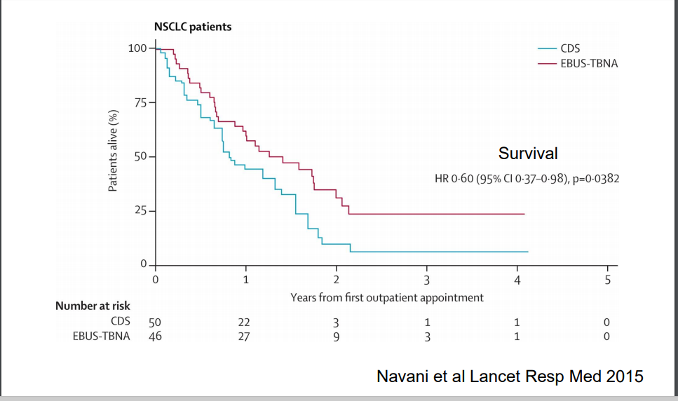
Median survival at 1 year better in EBUS group (503 vs 312)

Slide 15
Further evidence for faster treatment
Reported 16% increase in mortality if surgery delayed by >40 days from time of diagnosis (Yang C et al, ASCO abstract 2016)
Earlier treatment for NCLC associated with better survival outcomes
26% of patients self-report that their health deteriorates while awaiting a treatment decision (https://www.ncpes.co.uk)

Slide 16
Delivering a Service
1 full time respiratory consultant (10PAs) per 200 cases/year
Radiologists – 1/3 of job plan devoted to thoracic imaging
Medical/Clinical Oncologists- 1/3 of job plan devoted to thoracic oncology
Thoracic Surgical Unit- minimum 3 full time thoracic surgeons
One full time LCSN per 80 new diagnosis
One and half full time palliative care nurses per 200 stage IV patients

