Slide 1

SESSION PLANNER
  Why bother? The burden of the challenge.
  Treatment types for QST (quit smoking therapies)
    Behavioural techniques
    Pharmacotherapies
    Other interventions
  Special circumstances: the pregnant smoker
  E-cigarettes

Slide 2
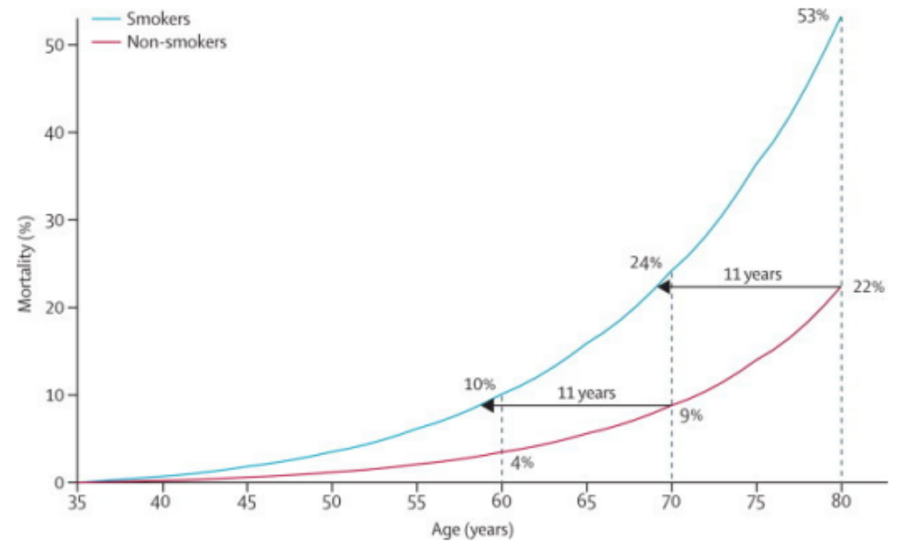
Smokers die early
Pirie et al Lancet. 2013 Jan 12;381(9861):133-41
Hayden McRobbie 2014

Slide 3
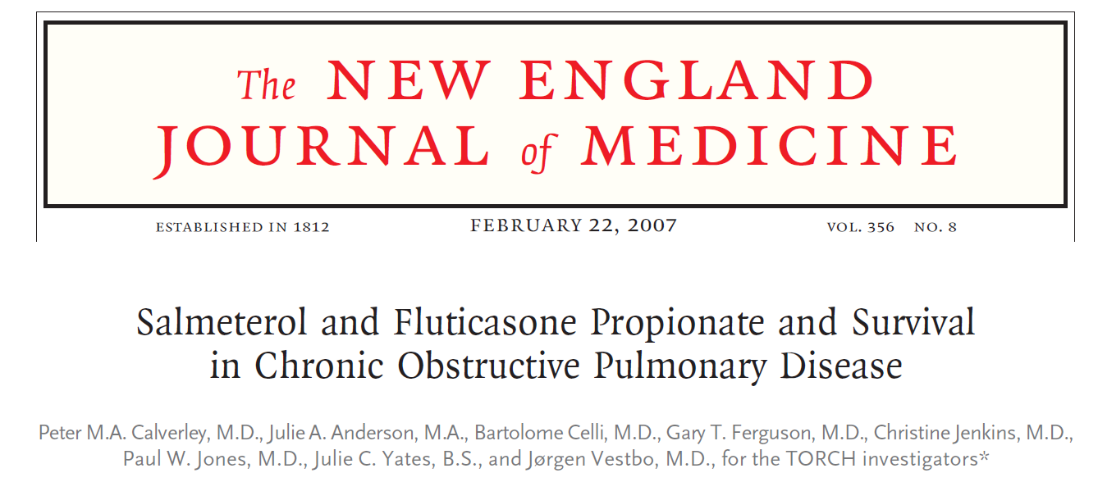
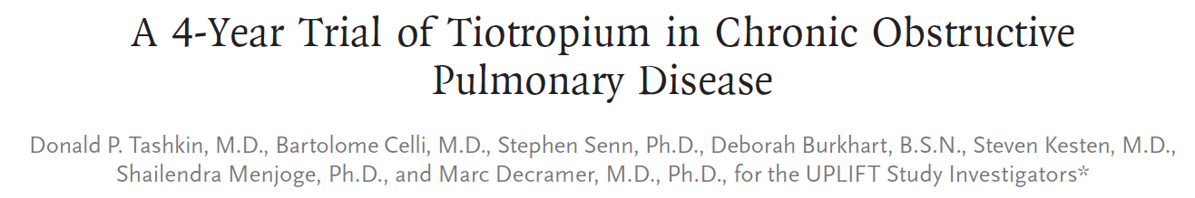
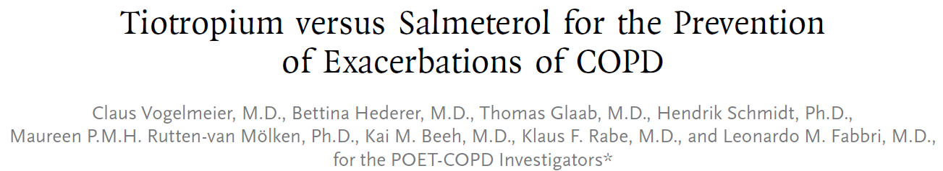

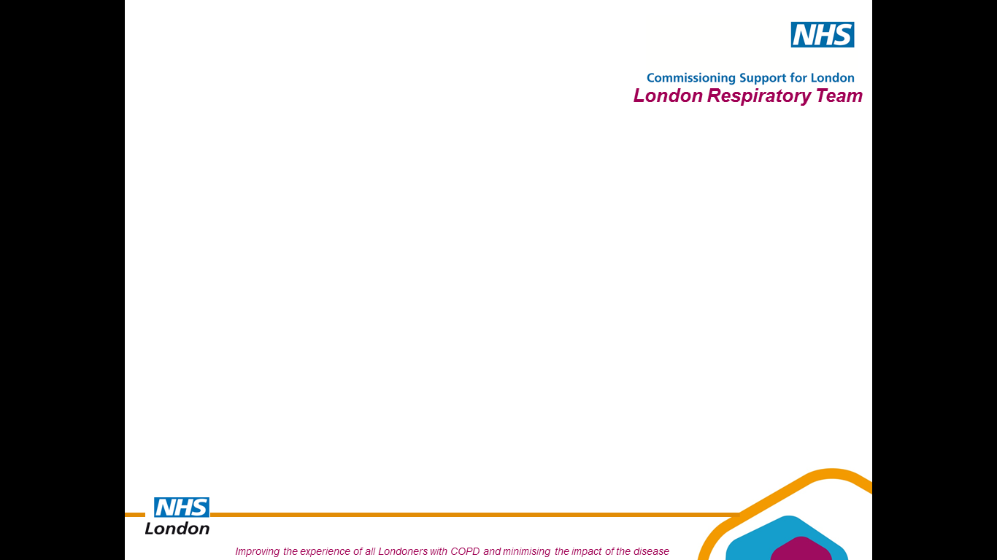
Is current smoking an issue in COPD?
TORCH, Uplift and POET-COPD Studies
Notes:
3

Slide 4
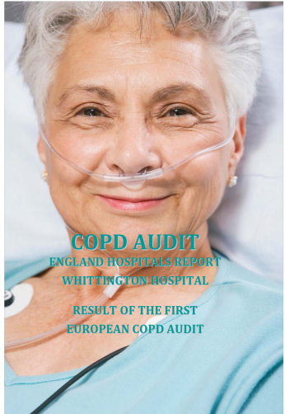
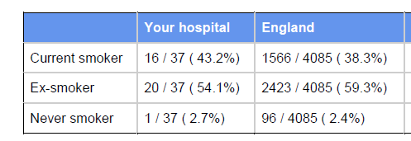
Is current smoking an issue in COPD?
2010 ERS Audit
Notes:
4

Slide 5
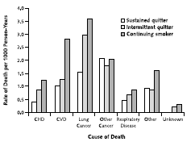
Effect of Smoking Cessation Intervention on Mortality in COPD
Randomised Clinical Trial
5887 people
with airway obstruction
over 14.5 years
Anthonisen NR, Skeans MA , Wise RA; Manfreda J, Kanner RE & Connett JE for the Lung Health Study Research Group*
Ann Intern Med. 2005;142:233-239.
Notes:
5

Slide 6
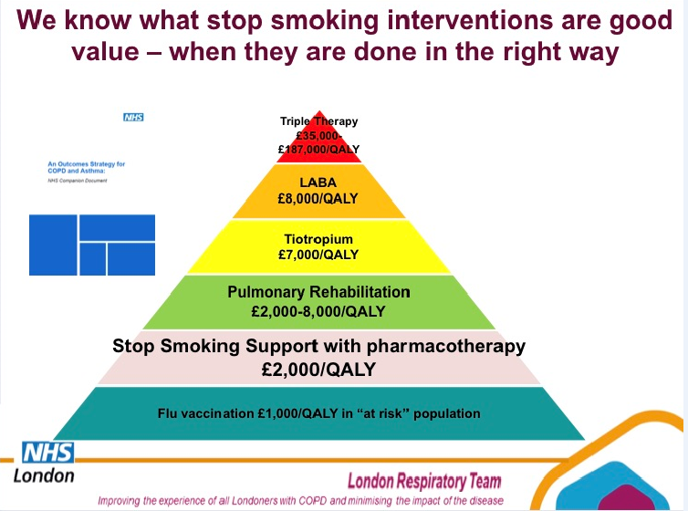

Slide 7
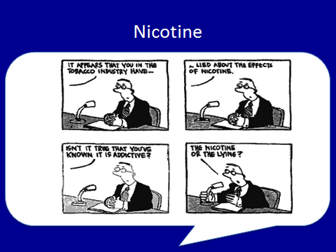

Slide 8
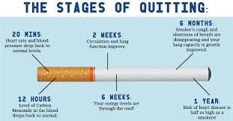
Approximately two-thirds of smokers say that they want to quit, and over half of smokers report that they tried to quit in the past year.
However, less than one-third of adult smokers who try to quit seek help, and even fewer use the most effective treatments.

Slide 9
Meta-analyses of clinical trials have found that behavioral counselling and pharmacotherapy both have strong evidence of efficacy for smoking cessation and that the combination of the two methods produces the better result.
With optimal treatment, 25-35% of smokers who try to quit can succeed for 6/12 or more.
In contrast, only 3- 6% of smokers who make an unaided quit attempt are still abstinent one year later.

Slide 10
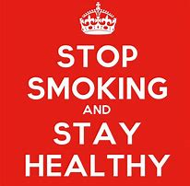
Behavioral counselling
Most studies demonstrate that quit rates increase with increasing behavioral support.
The most intensive behavioral intervention available, such as a specialty clinic or smoking cessation program, should be offered to the patient. For many patients, the only face-to-face option is brief clinician counselling in the office. This can be supplemented by external resources, such as telephonic quit line support and counseling, text messages and phone apps.

Slide 11
Pharmacotherapies
Combination of a long-acting NRT and a short-acting NRT, varenicline, and bupropion. Each medication has proven efficacy for smoking cessation.
For most patients, either varenicline or a combination of two NRT products (a patch plus a short-acting form such as the gum or lozenge).

Slide 12
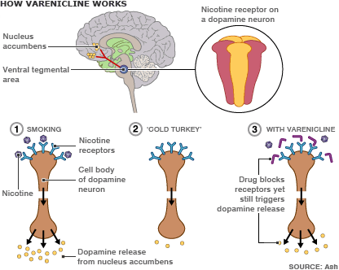
Varenicline
Varenicline = partial agonist of the α4β2 nAchR
Varenicline works by reducing craving for cigarettes making quitting smoking a little easier and increases the chances of stopping for good.
However it’s no magic cure and effort is still required.
Hayden McRobbie 2014

Slide 13

Bupropion
Atypical antidepressant which acts on dopamine and noradrenaline pathways and possibly as a nicotinic antagonist, designed to reduce motivation to smoke by
  reducing cravings and withdrawal symptoms
  reducing the rewarding effect of smoking
Works by alleviating craving and other withdrawal symptoms
It’s not a magic cure, but it will make quitting easier
Hayden McRobbie 2014

Slide 14
Bupropion: Long-term (>6 month) quit rates vs. placebo
Pooled 36 studies
RR=1.69 (95% CI:1.53-1.85)
Hughes JR, Stead LF, Lancaster T. Antidepressants for smoking cessation. Cochrane Database of Systematic Reviews 2007, Issue 1. Art. No.: CD000031. DOI: 10.1002/14651858.CD000031.pub3.
Hayden McRobbie 2014

Slide 15
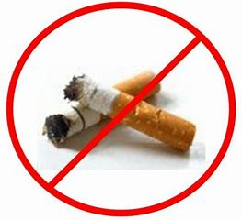
Other interventions
Several other types of interventions have been tried for smoking cessation, including financial incentives, which show some efficacy, and acupuncture and hypnotherapy, which do not have clearly proven efficacy.
Financial incentives for quitting smoking seem to improve smoking cessation rates while they are in place. RCTs have suggested that financial rewards (receiving up to $800 for smoking cessation) can increase quit rates.
Acupuncture was found to be less effective than NRT .
Meta-analysis of randomized trials of hypnotherapy for smoking cessation suggested potential benefits, whereas a prior systematic review of 11 randomized trials had found insufficient data to support the use of hypnotherapy for smoking cessation.

Slide 16
THE ROLE OF THE CLINICIAN
The "5A's" Approach — The clinician’s role is to document smoking status, offer advice to quit, evaluate the patient’s interest in quitting, and, for those interested in quitting, offer tools, techniques, and follow-up.
For those not ready to quit, the clinician can use motivational interviewing to move the smoker towards quitting.

Slide 17
●Ask about tobacco use (see 'Ask about tobacco use and exposure' below)
●Advise quitting (see 'Advise smoking cessation' below)
●Assess readiness to quit (see 'Assess readiness to quit' below)
●Assist smokers ready to quit (see 'Assist smokers ready to quit' below)
●Arrange follow-up
The 5A’s steps are as follows:

Slide 18
A suggested “proactive offer of treatment” approach is to begin by briefly presenting treatment-related facts, including the availability of treatment, and then ask whether the patient would like to quit smoking:
●Stopping smoking can be difficult
●Effective treatment for tobacco dependence is available
●I am prepared to help you, using available treatments
●Can I tell you more about these options?
●Maintenance of abstinence ( achieving quit)

Slide 19
Some critics noted that individuals do not move through predictable stages of behavior change. A 2010 systematic review of 41 trials concluded that stage-based help-interventions were equivalent to their non-stage-based equivalents.

Slide 20
SPECIAL CIRCUMSTANCES: the pregnant smoker
Maternal risks:
Subfertility — 13% of subfertility & delay in time to conception has been attributed to smoking. Chemicals in cigarette smoke, including heavy metals, polycyclic hydrocarbons, nitrosamines, and aromatic amines, appear to accelerate follicular depletion and may impede gametogenesis.

Slide 21
As women have delayed childbearing and smoking rates among young women have increased, there is the additional risk of coexisting smoking-related conditions such as lung cancer, hypertension, and asthma that could impact pregnancy.
Lung cancer during pregnancy is rare, but it is the second leading cause of mortality in women of reproductive age (25 to 39 years) and thought to be increasing due to the aforementioned factors. However, not all of the lung cancers diagnosed during pregnancy are smoking related.

Slide 22
Smoking risks- foetus/neonate
Spontaneous pregnancy loss, placental abruption, preterm premature rupture of membranes (PPROM), placenta previa, preterm labor and delivery, low birthweight (LBW), and ectopic pregnancy.
Miscarriage ( smoker mother and partner/passive)
Stillbirth and neonatal death — In a meta-analysis of 142 studies, any active maternal smoking increased the risk of stillbirth by nearly 50%
Congenital malformations — overall rate of congenital malformations not higher,smoking may increase the risk of specific anomalies e.g. cleft lip/palate,gastroschisis
SIDS, respiratory infections , asthma, atopy

