Slide 1

WHATS NEW IN ONCOLOGY 2018
KATE SCATCHARD
MEDICAL ONCOLOGIST RDE

Slide 2
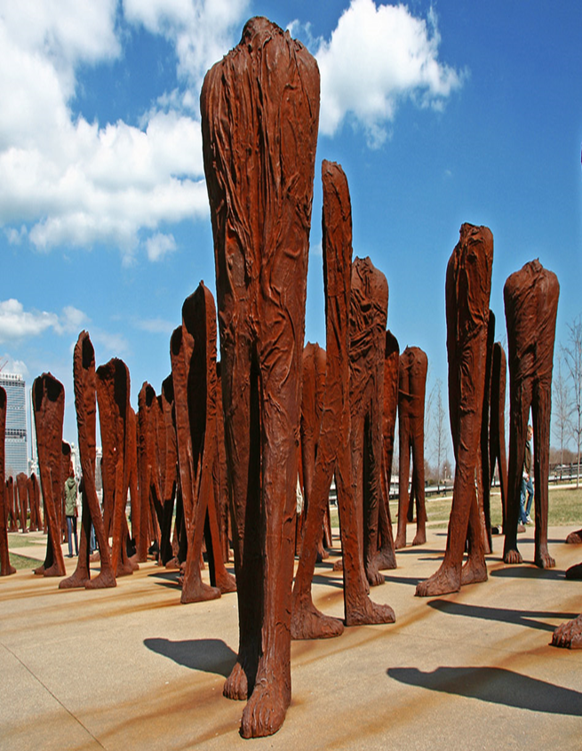
Its not just chemotherapy anymore
SACT- Systemic anti-cancer therapy includes:
Cytotoxics
Biologicals (mabs and nibs)
Immunotherapy

Slide 3
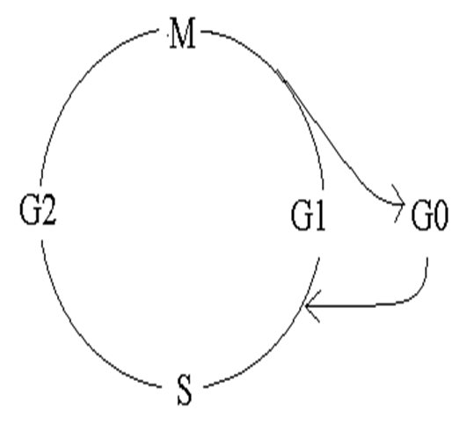
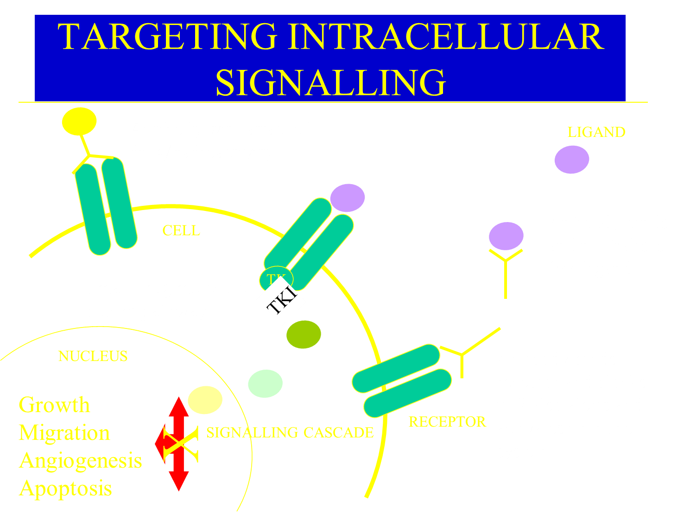
A reminder of the science
Chemotherapy damages DNA during cell cycle hoping to trigger cell suicide- but many cells are immortal
Growth signals can be blocked inside or outside cells but pathways cross and interact so easy to escape

Slide 4
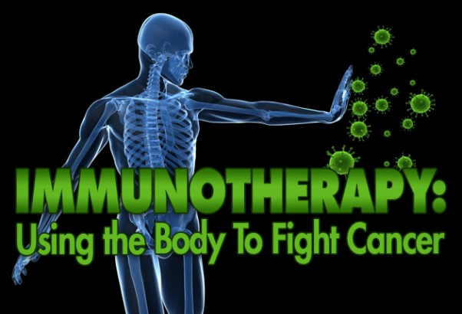
Whats new?…Not so much
Immunotherapy still flavour of the month
More drugs available
For more cancer types

Slide 5
Immunotherapy
Widely used currently in melanoma, renal, lung and bladder
  Ipilumumab
  Pembrolizumab
  Nivolumab
  Atezolizumab
Whats coming soon
  Chemotherapy + immunotherapy in lung
  More checkpoint inhibitors eg Relatlimab (anti-LAG3)
Notes:
Ipilumumab – MCA. CTLA-4 inhibitor. CTLA-4 normally functions as an inhibitory signal for CTLs to recognise and destroy cancer cells.

Slide 6
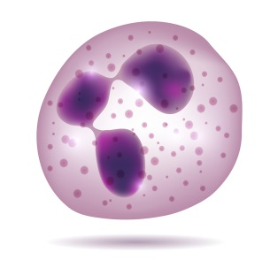

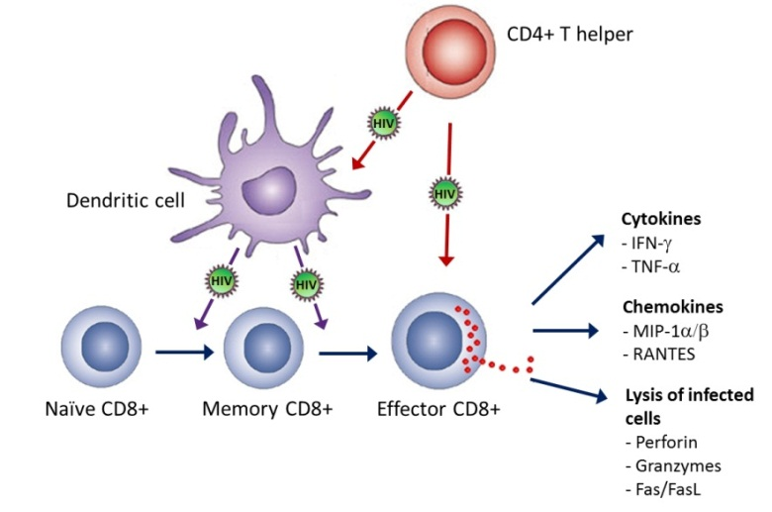
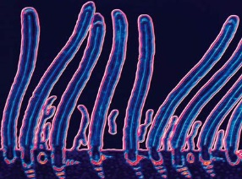
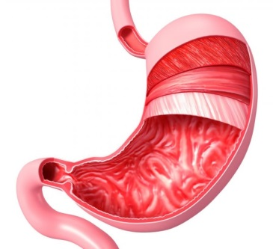
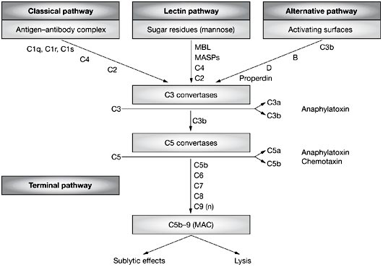
Refresher on basics of the immune system
Innate Immunity |  | Adaptive Immunity
Physical barriers | Internal Defences
Skin, hair, cilia Mucous membranes Mucus and chemical secretions Digestive enzymes in mouth Stomach acid | Phagocytic cells Natural killer (NK) cells Complement proteins Interferons | Antibodies and the humoral immune response Cell-mediated immune response Memory response

Slide 7
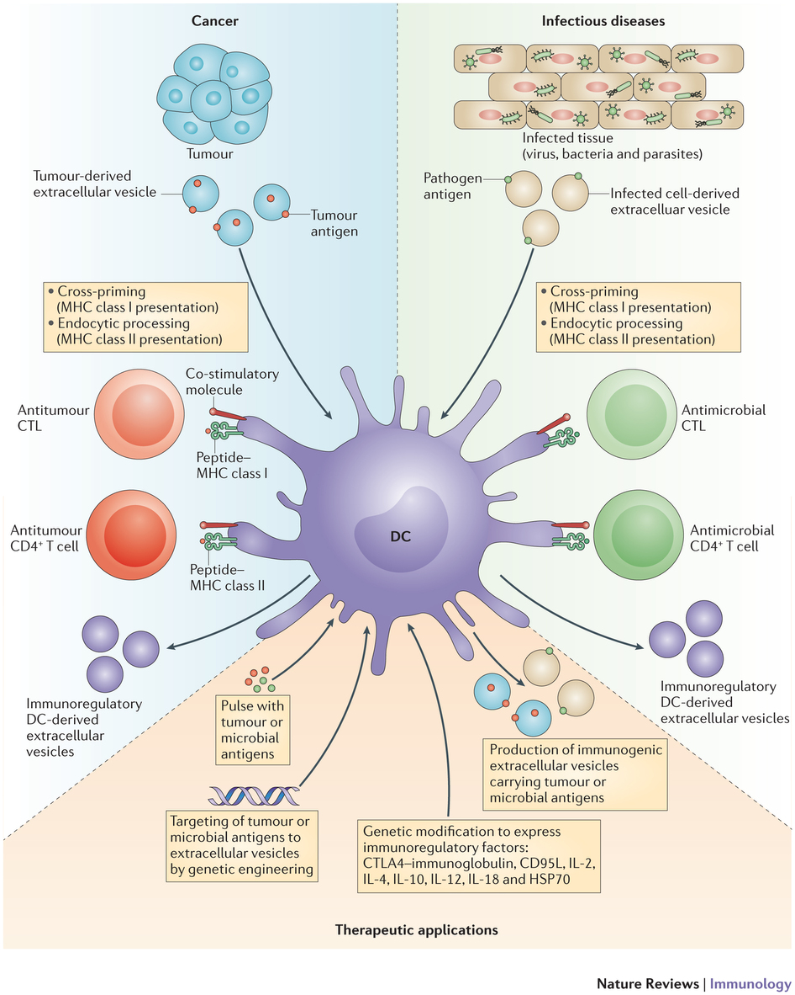
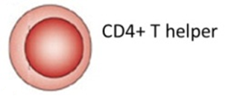
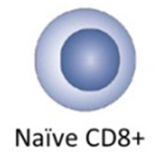


Slide 8
Three E’s of Immuno-editing
Elimination | Immune system detects developing tumour Immune response triggered, cancer cells killed Cancer cells eliminated before clinically apparent ‘I have cancer in me all the time’
Equilibrium | Some cancer cells persist, but supressed and kept at bay by immune system + ‘tumour dormancy’
Escape | Cancer cells find ways to get around the immune system recognising or suppressing them, allowing growth and visible tumours
Notes:
Elimination
The immune system is alerted to a developing tumour (via cytokines released by early tumour e.g. type I interferon)
An innate and adaptive immunity response is initiated and some tumour cells are eliminated, before it becomes clinically apparent
If fully successful, the cancer removed completely, otherwise events move to the next stage of equilibrium
Equilibrium
If some cancer cells persist, rare cell variants that escape the elimination are kept at bay by the adaptive immune response (with possible tumour dormancy)
May promote selection of immunoevasive mutations, leading to escape.
Escape
Tumours acquire the ability to circumvent immune recognition and/or destruction emerge as progressively growing, visible tumours
Recognised that both the innate and adaptive immune systems play a role in immune responses to tumour clearance.

Slide 9
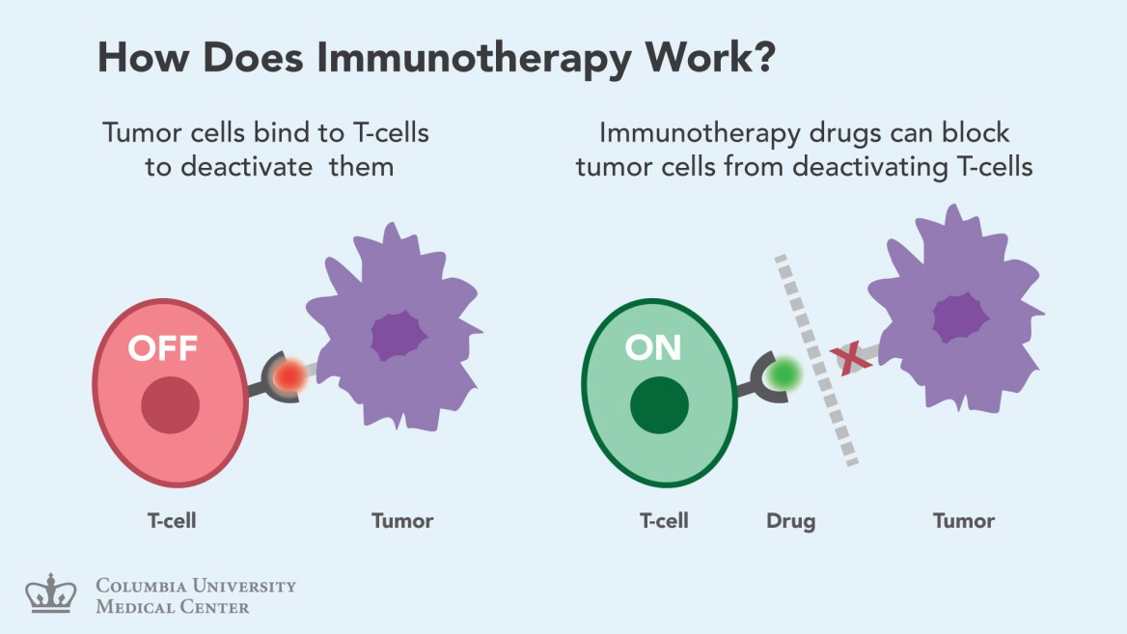

Slide 10
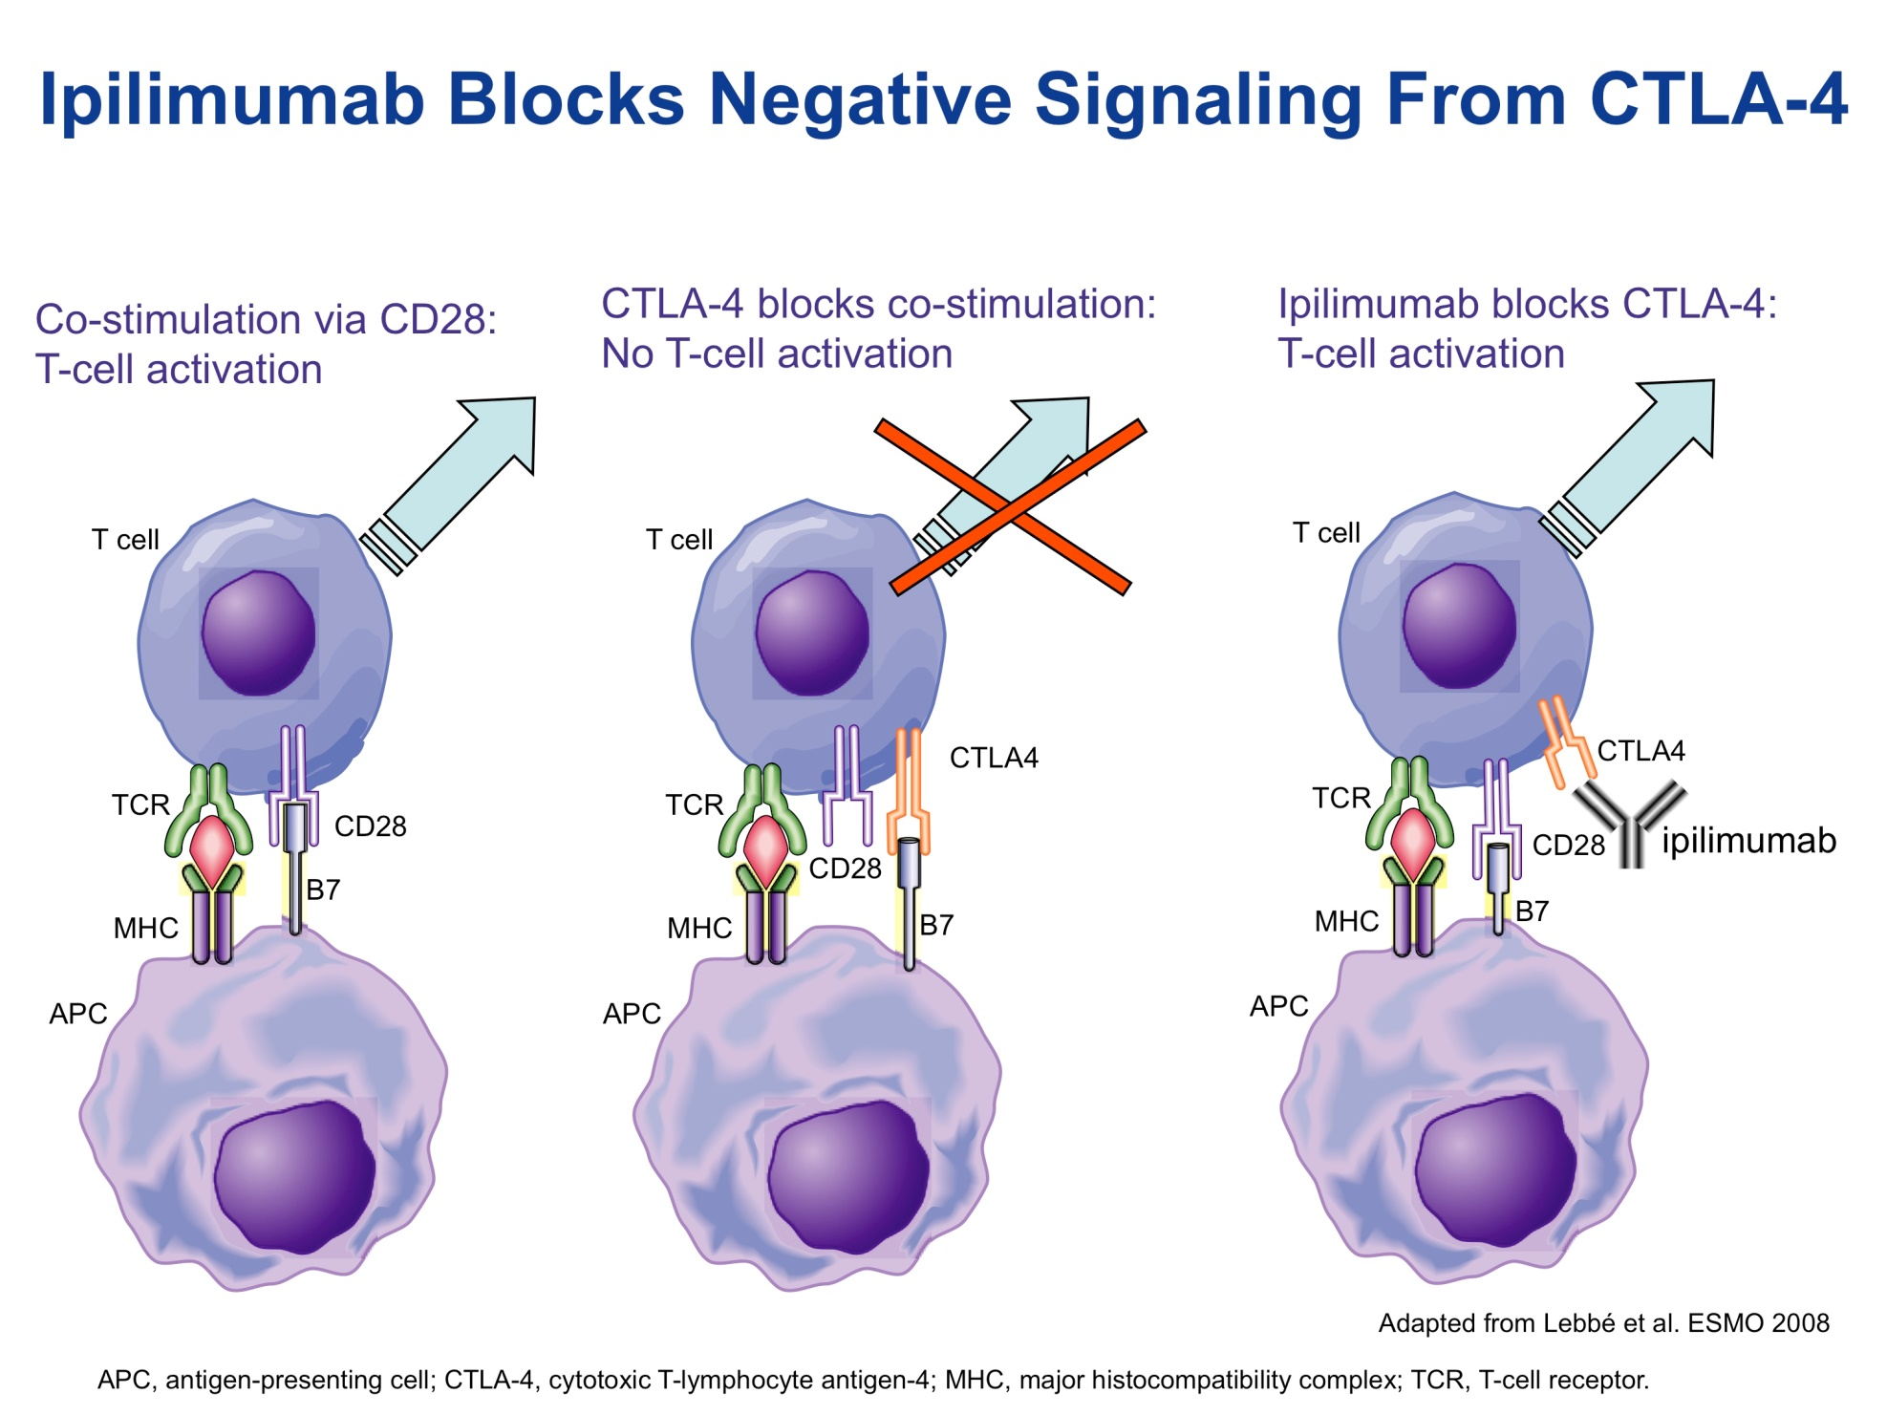

Slide 11
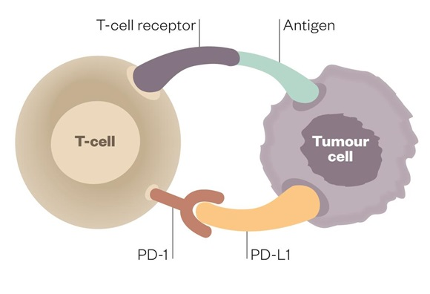
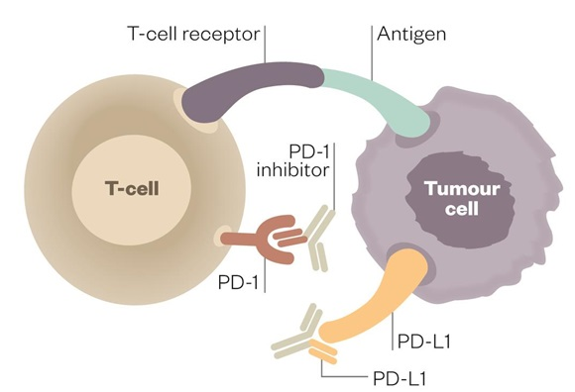
Pembroluzimab
Nivolumab
Avelumab
Atezolizumab
Notes:
T cell immune responses are controlled through on and off switches, so called ‘immune checkpoints’ that protect the body from possibly damaging immune responses.
The master switch for T cell activation was found to be the CD28-cytotoxic T lymphocyte associated antigen 4 (CTLA4) interaction.
In the following years, additional immune checkpoints were identified, such as programmed cell death protein 1-programmed cell death 1 ligand 1 (PD1-PDL1) and several others. They have different mechanisms of action – CTLA4 influences T cell activation and PD1-PDL1 pathway addresses T cell exhaustion and tolerance.
The modulation of immune checkpoints using monoclonal antibodies can have a universal effect on immune responses that is not dependent on tumour histologies, or individual cancer-specific antigens.

Slide 12
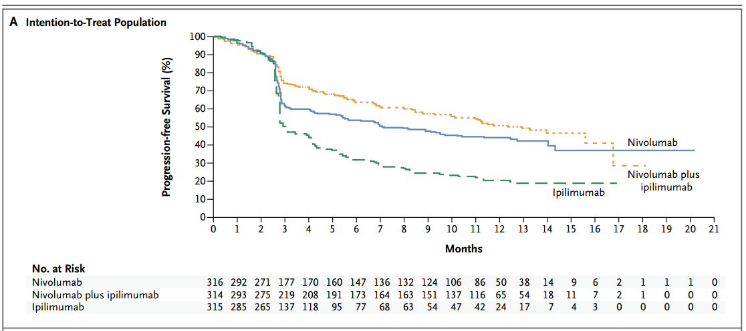
N Engl J Med. 2015 Jul 2;373(1):23-34. doi: 10.1056/NEJMoa1504030. Epub 2015 May 31.
Combined Nivolumab and Ipilimumab or Monotherapy in Untreated Melanoma.
Notes:
N Engl J Med. 2015 Jul 2;373(1):23-34. doi: 10.1056/NEJMoa1504030. Epub 2015 May 31.
Combined Nivolumab and Ipilimumab or Monotherapy in Untreated Melanoma.
Larkin J¹, Chiarion-Sileni V, Gonzalez R, Grob JJ, Cowey CL, Lao CD, Schadendorf D, Dummer R, Smylie M, Rutkowski P, Ferrucci PF, Hill A, Wagstaff J,Carlino MS, Haanen JB, Maio M, Marquez-Rodas I, McArthur GA, Ascierto PA, Long GV, Callahan MK, Postow MA, Grossmann K, Sznol M, Dreno B, Bastholt L,Yang A, Rollin LM, Horak C, Hodi FS, Wolchok JD.
Abstract
BACKGROUND:
Nivolumab (a programmed death 1 [PD-1] checkpoint inhibitor) and ipilimumab (a cytotoxic T-lymphocyte-associated antigen 4 [CTLA-4] checkpoint inhibitor) have been shown to have complementary activity in metastatic melanoma. In this randomized, double-blind, phase 3 study, nivolumab alone or nivolumab plus ipilimumab was compared with ipilimumab alone in patients with metastatic melanoma.
METHODS:
We assigned, in a 1:1:1 ratio, 945 previously untreated patients with unresectable stage III or IV melanoma to nivolumab alone, nivolumab plus ipilimumab, or ipilimumab alone. Progression-free survival and overall survival were coprimary end points. Results regarding progression-free survival are presented here.
RESULTS:
The median progression-free survival was 11.5 months (95% confidence interval [CI], 8.9 to 16.7) with nivolumab plus ipilimumab, as compared with 2.9 months (95% CI, 2.8 to 3.4) with ipilimumab (hazard ratio for death or disease progression, 0.42; 99.5% CI, 0.31 to 0.57; P<0.001), and 6.9 months (95% CI, 4.3 to 9.5) with nivolumab (hazard ratio for the comparison with ipilimumab, 0.57; 99.5% CI, 0.43 to 0.76; P<0.001). In patients with tumors positive for the PD-1 ligand (PD-L1), the median progression-free survival was 14.0 months in the nivolumab-plus-ipilimumab group and in the nivolumab group, but in patients with PD-L1-negative tumors, progression-free survival was longer with the combination therapy than with nivolumab alone (11.2 months [95% CI, 8.0 to not reached] vs. 5.3 months [95% CI, 2.8 to 7.1]). Treatment-related adverse events of grade 3 or 4 occurred in 16.3% of the patients in the nivolumab group, 55.0% of those in the nivolumab-plus-ipilimumab group, and 27.3% of those in the ipilimumab group.
CONCLUSIONS:
Among previously untreated patients with metastatic melanoma, nivolumab alone or combined with ipilimumab resulted in significantly longer progression-free survival than ipilimumab alone. In patients with PD-L1-negative tumors, the combination of PD-1 and CTLA-4 blockade was more effective than either agent alone. (Funded by Bristol-Myers Squibb; CheckMate 067 ClinicalTrials.gov number, NCT01844505.).

Slide 13
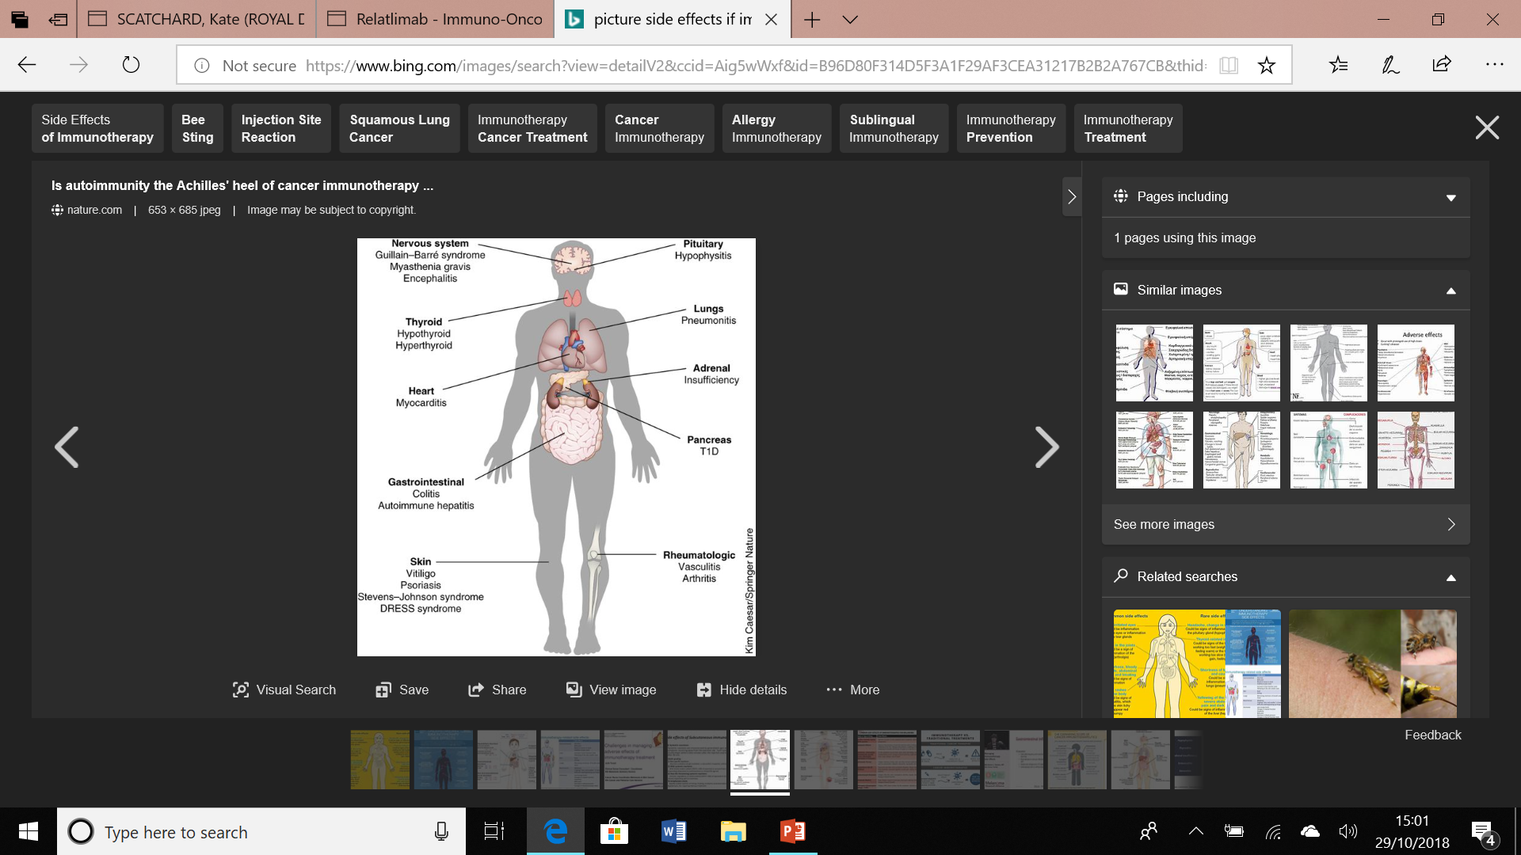

Slide 14
Treatment of side-effects
Mild/moderate: 1mg/kg Prednisolone po
Severe: 1-2 mg/kg Methyl prednisolone iv
Consider additional agents eg Infliximab
Replace hormones in endocrinopathy

Slide 15
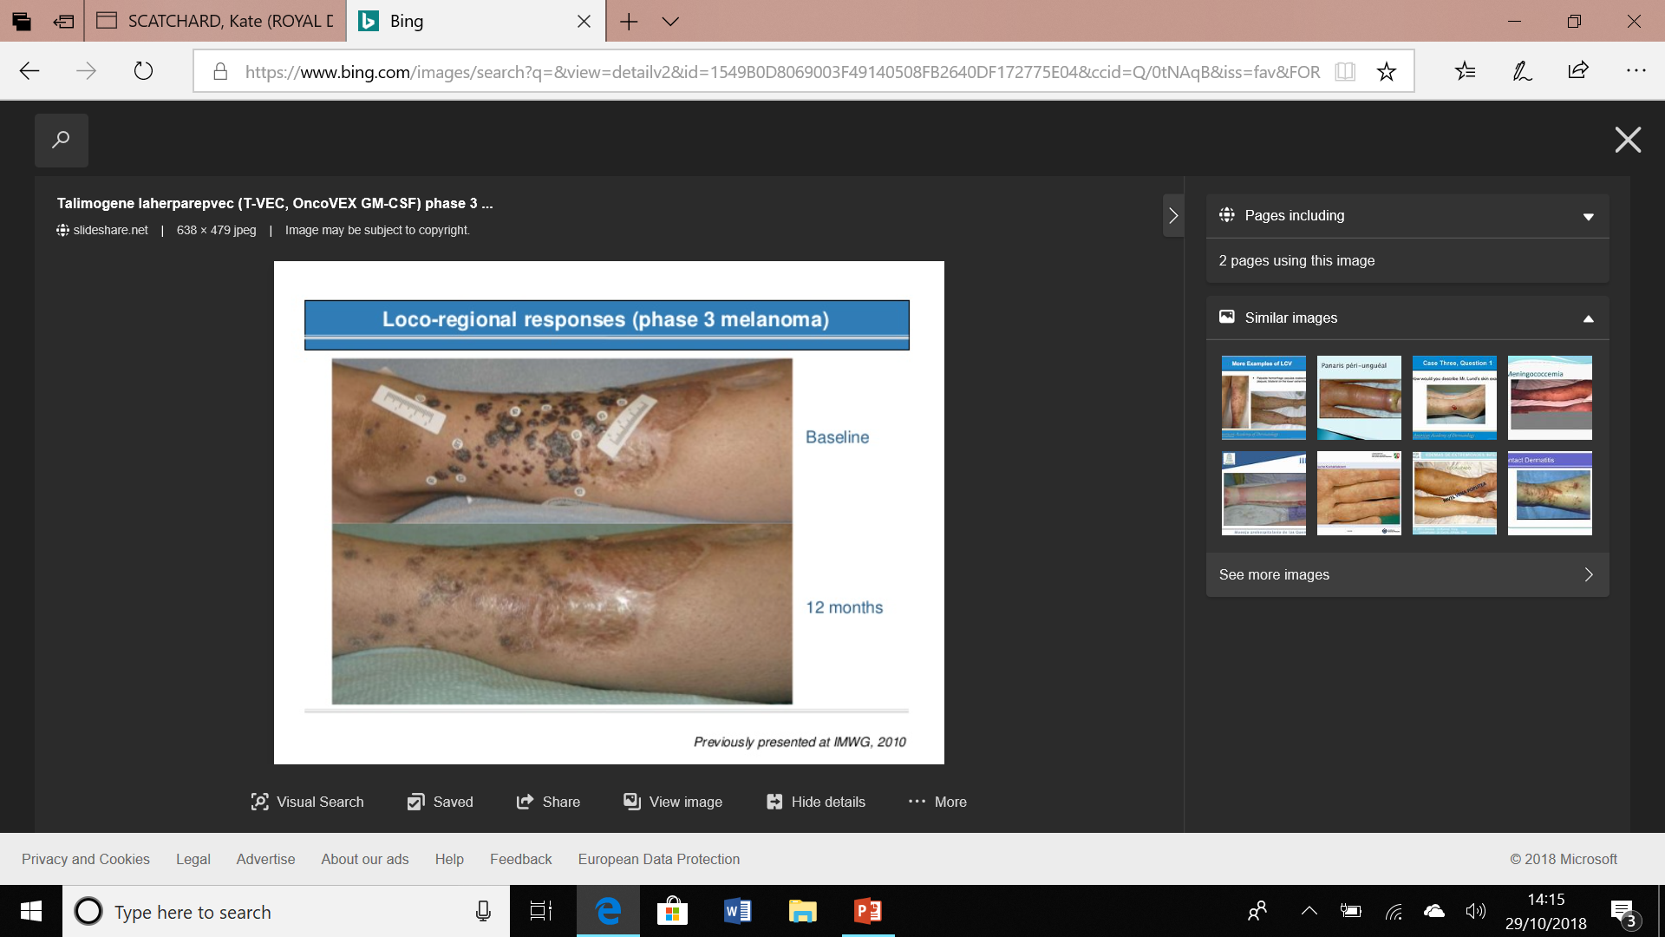
Next steps IΦ: T-VEC
Live attenuated HSV-1
Oncolytic
Secretes GM-CSF
Inject s/c lesions
Bystander effect
50% CR
S/E: fatigue, ‘flu’, pain
Early Trials + syst IΦ show 70% ORR

Slide 16
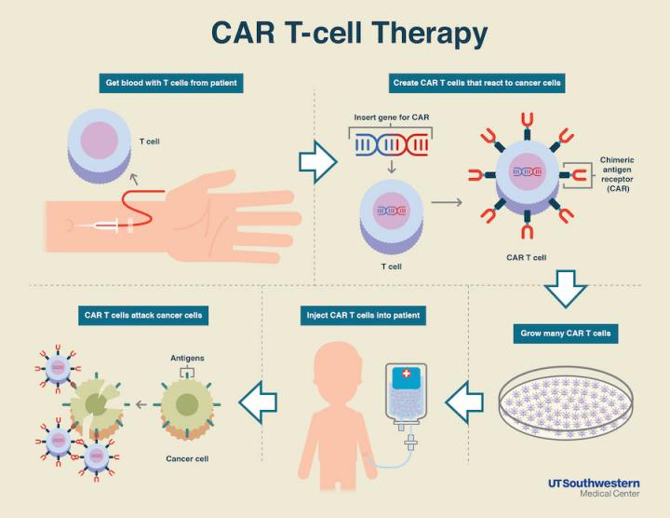
Next steps IΦ: CAR-T
Notes:
Adoptive cell transfer needs to deplete innate immune system with chemo before giving cells back. Currently only for blood ca espec ALL
Chimeric Antigen Receptor (CAR)- combines antigen binding with T cell activating function in 1 receptor
s/e cytokine release sy (massive inflam response can result in multi-organ failure), neurotoxicity (incl cerebral oedema), insertional mutagenesis, anaphylaxis

Slide 17

Nibs
All oral continuous flat dosed Rx
Intra-cellular signalling pathways
Inhibit tyrosine kinases eg imatinib

Slide 18
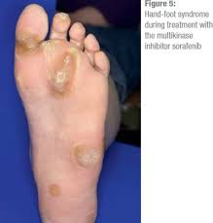

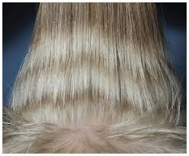
Side effects of nibs
Very different to chemo
Drug specific and unusual
Fatigue/ D/ myalgia
Skin- very common
Pyrexia with dabrafenib
Cardiac toxicity with anti-HER2 drugs

Slide 19
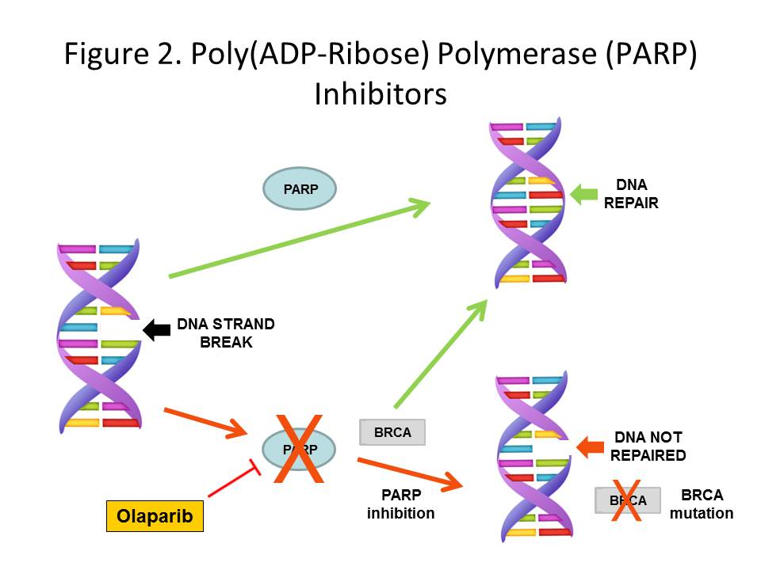
PARPIs (Olaparib, Niraparib, Rucaparib)
Maintenance therapy after 2nd or 3rd response to carboplatin in Ovary
SE:
  Low FBC
  GI upset
  Fatigue/appetite
  Pneumonitis
  MDS/AML
Future role in breast and prostate CA

Slide 20
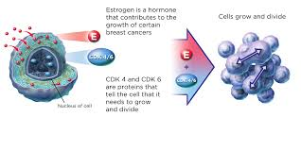
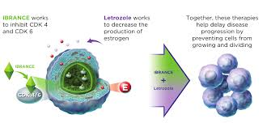
AND ALSO CDKI (ciclibs)
Palbociclib / Ribociclib
Met breast
21d on 7d off
With cont letrozole
Cdk 4/6I (blocks CC)
PFS 10 vs 20/12
SE:
  Low FBC
  PE
  D
  Neuropathy

Slide 21
Old drugs new uses….
Bisphosphonates in adj breast cancer
Absolute benefit of 3% in reducing risk of death in post-menopausal women
4mg zoledronic acid iv 6/12 for 3 years
Potential for double prescribing

Slide 22

FUTURE OF CLINICAL TRIALS- BASKETS
Rare mutation driving several cancers
Eg BRCA in breast, prostate and ovary
Hard to do trial in BRCA+ ovary
Molecular profiling identifies actionable target
Less chance of false negatives

Slide 23

FUTURE OF CLINICAL TRIALS-UMBRELLAS
Some cancers have multiple diverse mutations
ALK occurs in 1% NSCLC
An Umbrella trial groups numerous small trials into 1 big one
Arm chosen by mutation characteristics
Can add/remove arms without stopping trial

Slide 24

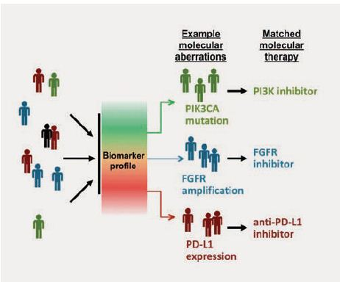
Molecular profile tumour- 28 genes
17 mutational groupings
Multiple arms of targeted drugs:
  AZD5363
  AZD4547
  AZD2014
  AZD09291
  Crizotinib
  Palbociclib
  Selumetinib+docetaxel
  PDL-1 Ab if no actionable muts

Slide 25

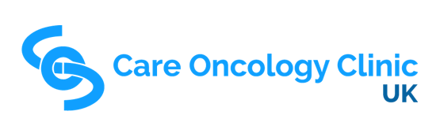

Slide 26
AND LESS CONVENTIONALLY I
NALTREXONE
  Binds opiate R
  For reversal opiate toxicity and Mx addiction
  4.5mg po on
  ?Stimulates Th 1 (cell mediated immunity)
  ?promotes growth arrest
METFORMIN
  Oral hypoglycaemic
  DM on metformin get less cancer and do better
  Ongoing trials of metformin in prostate, breast and endometrial CA
  ? Acts via IGF-1/ mToR pathway
Notes:
Care oncology clinic £400 initial consultation, £200 for f/up consult every 3 months then £80-100 drug costs monthly

Slide 27
AND LESS CONVENTIONALLY II
Mebendazole
Dose 100mg bd po
Anti-parasitic
Anti-neoplastic in cell cultures and mice
2 case reports
Subj of 2 ph 1/ 2 trials in paed brain tumours
Statins
50% of CA have mut p53
Encourage degradation of mutant p53
Poss decr CA incid in statin users- metanal didn’t confirm
No benefit from adding statin to chemo for met CA
Notes:
Wt p53 promotes CC arrest for DNA repair and apoptosis. Mut p53 doesn’t work therefore doesn’t do this helping cells escape from CC control

Slide 28
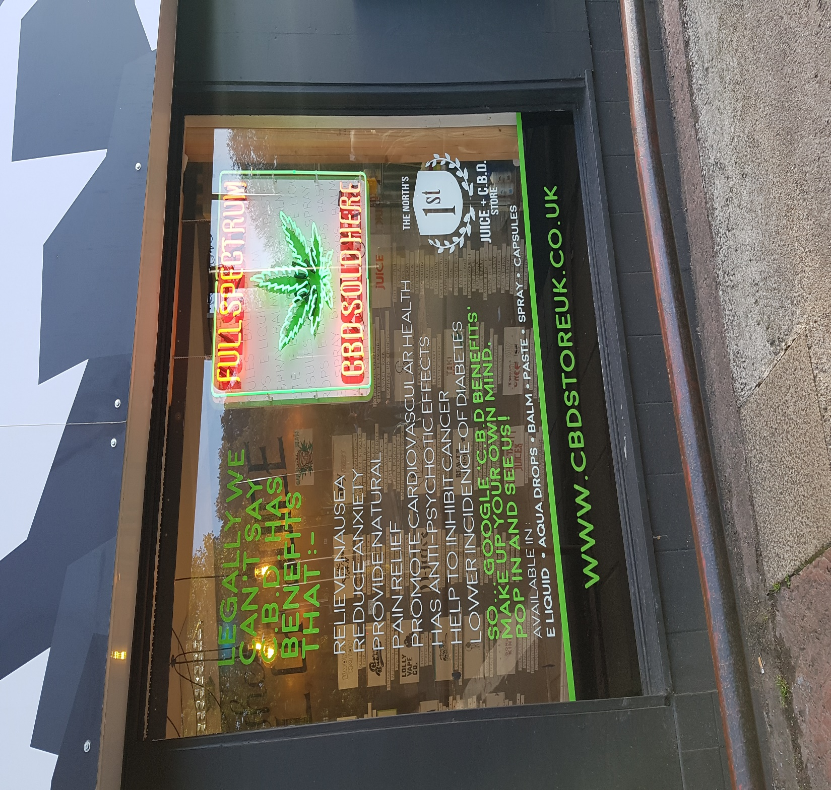

Slide 29
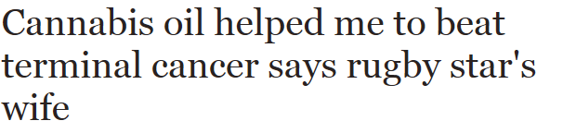
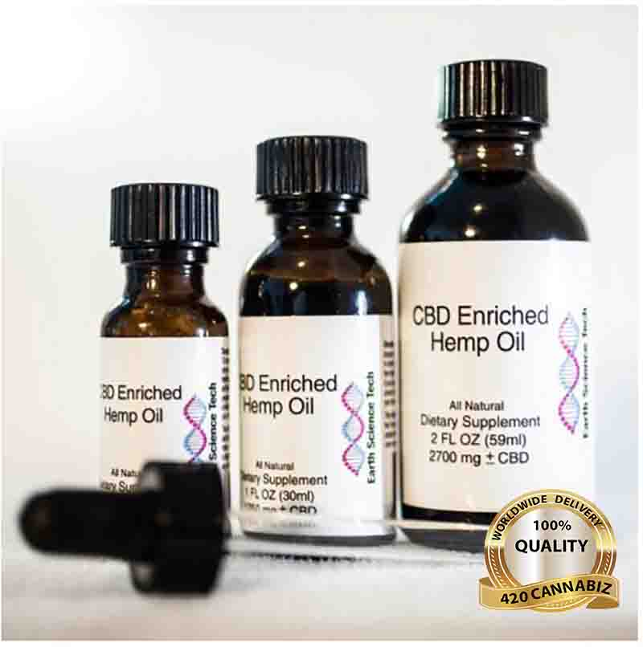
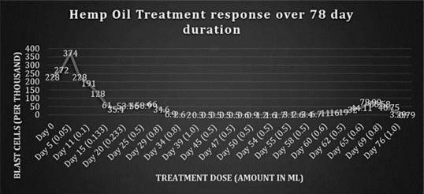
V popular at present
CBD improves pain, nausea, appetite, mood etc
In cell culture –promotes cell death, CC inhibition, anti-angiogenic
Not proven in clinical trials
Case Rep Oncol. 2013 Sep-Dec; 6(3): 585–592.
Notes:
Want <2% THC or will get high
Ideally >8-12% CBD

Slide 30
Cannabis and the law
Cannabis and cannabis oil still illegal
CBD oil/extract/tinctures now legal to buy
CBD oil will be a prescribable medicine from 1/11 if
  Exceptional need
  Chemo-induced nausea/vomiting
  Chronic pain/ spascticity eg with MS
  Intractable childhood epilepsy
NICE guidance due oct 19
Notes:
CBD- cannabidiol
THC

Slide 31
What next?
BREXIT
EU spent 1.5bn euros on research 2007-14
UK teams got 150m of this
Drug and trial regulation currently pan-European and largely UK-based.
UK accounts for 3% global drugs market
EMA moving to Amsterdam no guarantee of continued membership
If so likely 6-12 month delay in drugs access at least

Slide 32
