Slide 1
Bristol Tuberculosis Nursing Team
Liz Jones, Team Lead

Slide 2
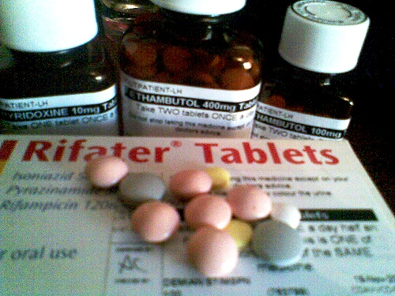
Notes:
TB meds –would you be motivated to take 11 pills everyday for 2 months before you’ve had your breakfast?

Slide 3
Treatment Adherence
Millions of patients begin TB treatment every year, but face constant challenges to comply with daily medication.
Inconsistent adherence or premature stoppage increases the risk of
Aquiring drug resistance and treatment failure
prolong transmissibility
Disease progression
Relapse and death
(Borgdorff, Floyd, Broekmans. Interventions to reduce TB mortality in low and middle income countries. Bull WHO 2002: 80:217-27)

Slide 4
Factors influencing treatment adherence
Poverty, unstable accommodation, poor social networks or support.
Ethnicity, gender, age, knowledge and beliefs, cultural beliefs, altered mental state. Substance abuse and stress
Complex regimen: pill burden, toxicity, side effects, treatment duration.
Service organisation, access and flexibility, empathic and expert professionals, patient support.

Slide 5
Lost to follow-up
Occurs when patients have negative treatment experiences such as
Access to care involves substantial travel time, loss of earnings
Adverse drug reactions
Co-concomitant health conditions (HIV)
Substance abuse
Homelessness
Financial hardship

Slide 6
Any of the following factors?
Has not adhered to Rx in past
Recurrent TB
Homeless / recent history
Alcohol / substance misuse or history of
Prison or recent history of
Major memory / cognitive / psychiatric disorder
In denial of diagnosis
MDRTB
Too ill to self-administer
Any of the following factors?
Socially complex
Clinically complex
Spinal / CNS TB
HIV co-infection
Co-morbidities
Rifampicin resistance
Language barrier
H/o serious side effects
Pathway 1
No significant risk factors, routine follow-up.
Pathway 3
Offer and advise DOTs
Pathway 2
Enhanced Case Management
Visits 1-2 weekly
Compliance aid
Pill counts
Support with social / other factors
Accepts
Declines
Decide if daily or thrice weekly
Identify DOTs site
Identify DOTs supervisor
Write and sign contract for DOTs
If pill count discrepancies / other concerns re compliance take “standard advised actions” and review pathway
Notes:
Risk assessment recommended treatment pathway

Slide 7
Pathway 2 and 3 toolkit
Face to face Dots
Daily visits to health centre to see TB nurses.
TB Nurses visit patient at home (usually only sustainable for a limited time)
Weekend doses given to patient
Challenges:
Need a motivated patient to maintain attendance
Staff capacity to be available. (often late or DNA, time wasted)
Enablers such as bus passes or taxi fare
Limited choice of incentives (coffee??)
Notes:
Enablers and incentives are useful but there is no funding available for them. We have a small hardship fund which we can use for our most destitute patients but its not a sustainable source of funding.

Slide 8
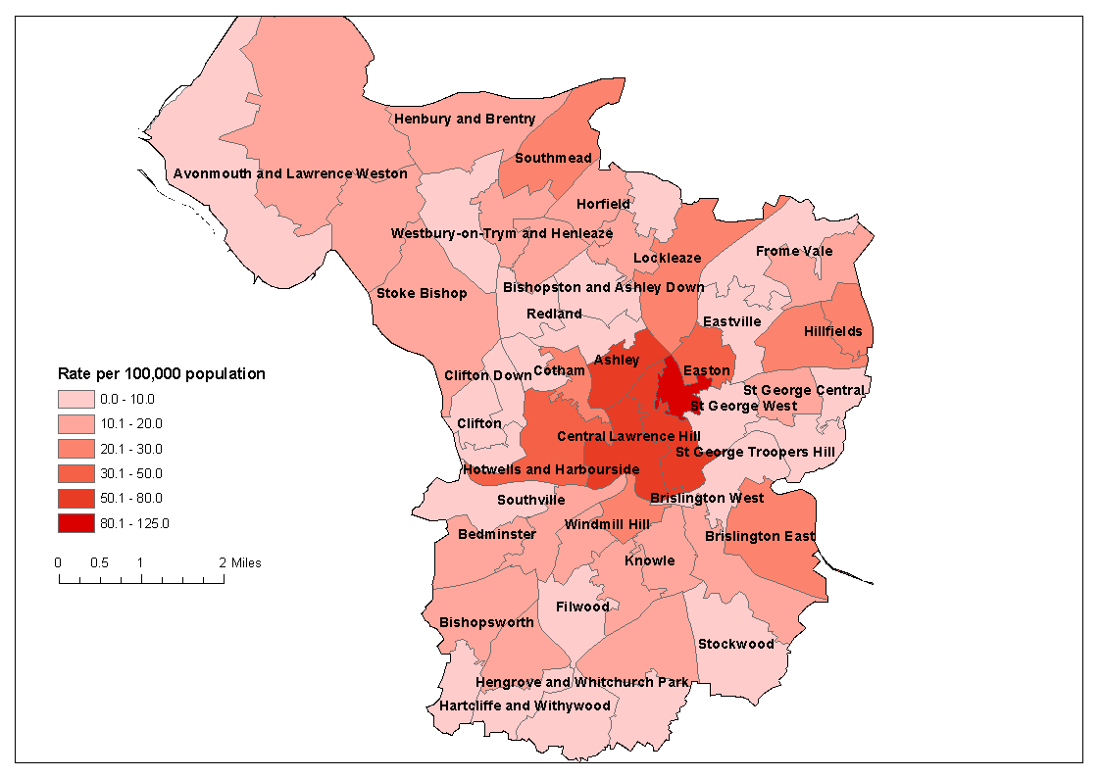
Bristol TB incidence rates by Borough
TB nurse base
Notes:
Distance from Health centre or to patients home, however we are based in the city where the highest rates of TB occur.

Slide 9
Thrice weekly/ weekly DOTs
See patient either at home or at health centre
Witness taking meds and provide following day or week to take independently and at weekends
Provide meds in dossett boxes.
Slightly more independence for patient
TB nurse still able to keep in very close contact
Ensure treatment is being taken and side effects monitored.
Risks with DNA or patient being out.

Slide 10
Pharmacy DOT
Set up in Bristol only
Challenges:
Been used very effectively for patients also on opiate substitution therapy.
Receive TB meds alongside their Methadone or subutext from their pharmacist
Pharmacist keeps a log of compliance and informs TB team
Service has been offered to other patients who need DOTs but are not on OST.
Provides flexible time frame to attend for treatment, set up locally to their home and some have weekend cover too.
Success has been more limited in theses patients
No incentive to attend
Notes:
Eg of DM where he did not engage with TB service at all but saw his pharmacists and completed 6 months of treatment.
HM who started to engage but there was no incentive as not on OST

Slide 11
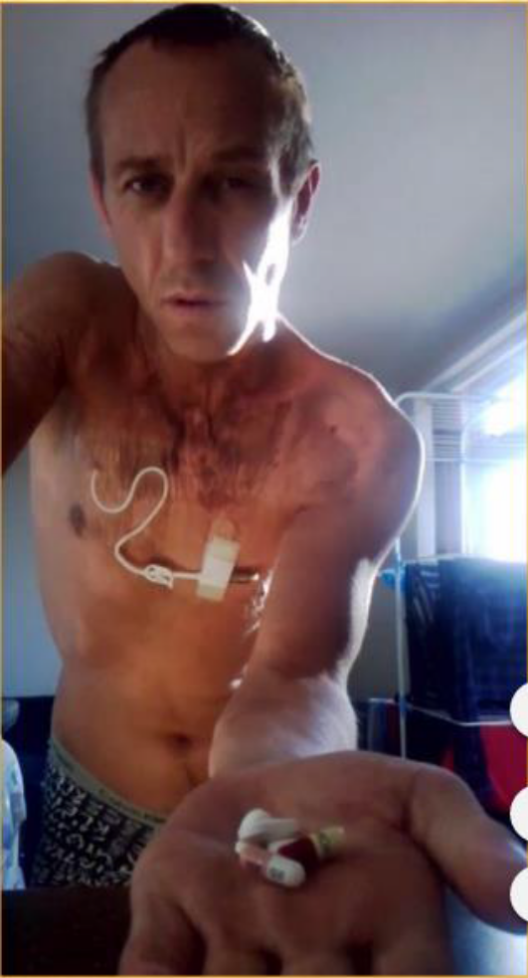
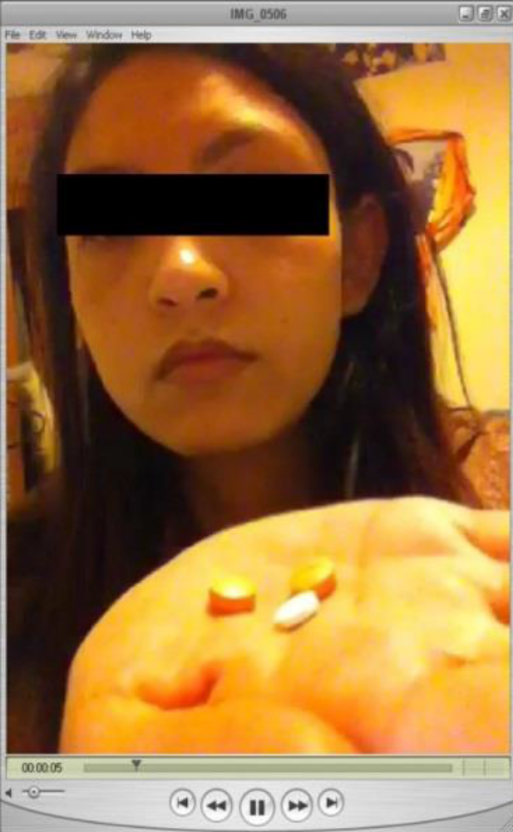

Video Observed Therapy
Notes:
Increased availability of smart phones provides another solution.

Slide 12
VOT- How it works
Patients video themselves taking their treatment via their smartphone.
Videos are submitted to the TB team to view ensuring there is compliance.
Patient signs a consent form understanding the requirement for them to do this daily and for every dose.
TB nurses record the compliance and then delete the videos. Send messages of encouragement.
Notes:
We have used this in Bristol very successfully but via a watts app with the full consent of patients but it does raise information governance issues

Slide 13
VOT Trial
London Find and Treat team have been conducting a randomised control trial on the effectiveness of VOT v DOT.
Developed an App that is downloaded to the smartphone easy for patients to use and has multiple languages available.
Videos are uploaded by the patient to the app via a secure server accessed only by the TB team to view.
Notes:
All London CCG’s will fund patients for VOTs

Slide 14
Highlights of the trial
Hypothesis: VOT increases the proportion of patients who have ≥ 80% of doses observed during a 2 month period compared to DOT.
Inclusion criteria: Any patient 16yrs or older eligible for DOT.

Slide 15
Results
58% of 226 randomised patients had a history of homelessness, drug use, imprisonment, alcohol or mental health problems.
Of the 112 patients randomised to VOT, 70% had over 80% of scheduled observations completed over two months (the primary outcome measure) compared to 31% of 114 patients randomised to DOT (p<0.001).

Slide 16
Results cont:
The effect was, in part, due to 51% of those randomised to DOT having less than one week of observation (compared to 10% of those randomised to VOT), and so not starting treatment with their allocated regimen.
VOT patients sustained high observation levels throughout treatment, whereas this declined rapidly in DOT patients.
We estimate that observation of a six month course of treatment with daily VOT cost £1645 per patient compared to £5700 for five times per week DOT.

Slide 17
Conclusions
The trial concluded VOTS is
At least twice as effective as DOT
More acceptable to patients than DOT
More acceptable to providers than DOT
Cheaper (less than half the cost of clinic DOT and one third cheaper than community DOT)

Slide 18
Patient views on VOTs
How does VOT compare with DOT?
“ with the DOT, it felt like you had a disease and you felt like there was some kind of stigma and for that reason they are monitoring you- It felt almost like being a criminal.. I felt like probably they don’t trust me to take my own medication…but with VOT, its different.. Its definitely a welcome alternative”

Slide 19
Continued
How do you feel about sharing your image?
“ Its important to know the person-if you forget to send the video they can call you back and they will remind you. It’s much better to know who you are dealing with”
Patients report VOTs as liberating, flexible and empowering.
Story A, Aldridge R, Smith C, et al S29 A randomised controlled trial comparing smartphone enabled remote video observation with direct observation of treatment for tuberculosis. Thorax 2017;72:A21.
Notes:
This looks to be a promising and effective tool in treatment compliance, however patients needs remain complex and still require a therapeutic relationship with the TB team to be fully successful

Slide 20
Adherence to treatment Summary
Role of the TB Team
Assess and understand the needs and situation/ lifestyle of your patient.
What support or intervention will work best for them to achieve treatment completion and cure. (Benefits, housing, food vouchers).

Slide 21
Build a supportive and trusting relationship with patient, educate about TB, bust myths.
Mitigate side effects where possible.
keep encouraging, engaging and supporting the patient to complete their treatment right to the end of the course.
High risk of poor compliance at 3-4 month stage.

Slide 22
“The cornerstone of effective TB management has long been recognised to lie within the complex inter-relationships between patients and clinical staff, and to hinge strongly on structural facilitators to the treatment-experience, along with empathy”
Metcalfe et al. Moving Beyond Directly Observed Therapy for Tuberculosis. 2015

Slide 23
Thank you

Slide 24
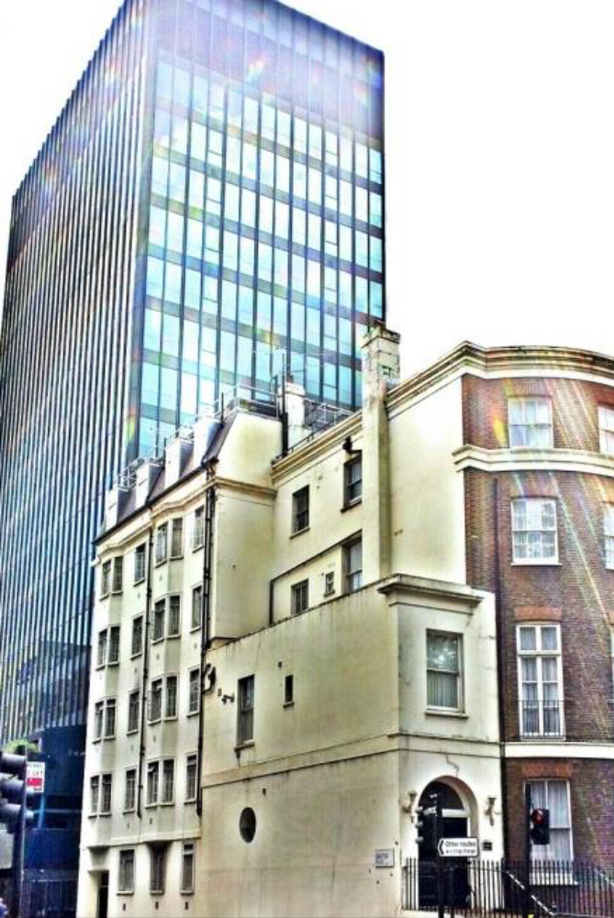
Ollalo House TB Hostel in London

