Slide 1

Role of the ILD Nurse in
Management of patient with ILD
Michelle Morales
Naomi Rippon
ILD Specialist Nurses
Bristol Interstitial Lung Disease Service
Exceptional healthcare, personally delivered

Slide 2

NICE Quality Standards
Idiopathic Pulmonary Fibrosis (QS79) January 2015
List of quality statements
Statement 1. People are diagnosed with idiopathic pulmonary fibrosis only with the consensus of a multidisciplinary team with expertise in interstitial lung disease.
Statement 2. People with idiopathic pulmonary fibrosis have an interstitial lung disease specialist nurse available to them.
Statement 3. People with idiopathic pulmonary fibrosis have an assessment for home and ambulatory oxygen therapy at each follow up appointment and before they leave hospital following an exacerbation of the disease.
Statement 4. Pulmonary rehabilitation programmes provide services that are designed specifically for idiopathic pulmonary fibrosis.
Statement 5. People with idiopathic pulmonary fibrosis and their families and carers have access to services that meet their palliative care needs.

Slide 3
Role of the ILD CNS
Information and education – develop a rapport
Co-ordinate and navigate care, encourage normality
Identify for clinical trials
Benefits advice
Referral to early PR which is tailored to the individual needs
Telephone advice: medication, symptom management etc
Oxygen review at every clinic and in patient episode / travel advice
“Safety net” refer to and maintain effective communication between HCP’s in primary/secondary care, social care referral
Counselling for assessment for lung transplant
Liaise with palliative care services throughout the pt journey and refer early. Focus on improving symptoms of SOB, cough, fatigue and improves QOL. IPF is predictably unpredictable!

Slide 4
What do our patients want to know?
Why am I breathless?
Why is my cough so troublesome?
What is wrong with me?
What treatment is available?
What can I expect to happen in the future?
How bad might this get?
How can I help myself?
Exceptional healthcare, personally delivered
Notes:
ILD’s are not common conditions – pts have a need for information

Slide 5
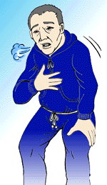
Clinic review
Build relationship
Discuss significance of PFT’s and 6 MWT
Consider clinical trials
Goal – to keep active and maintain normality
Explanation of investigations + -diagnosis
Refer for P Rehab
Financial implications
Review symptoms, cough and breathlessness
Advice re flu/ pneumonia vac
Rescue ab’s
Oxygen assessment / review
Holiday advice
Smoking cessation
Benefits advice / Blue badge
BTS registry
nutrition
Refer/liaison with com matron, OT, physio, D/N, SW, hospice services, SS etc
Transplant consideration
Lifestyle changes
Fear of dependence on others
Unpredictable future with advancing
disease
Identify exacerbations
ACP
Notes:
The ILD nurse should be available at all stages of the pathway to provide information about investigations, diagnosis and management to pts and carers

Slide 6
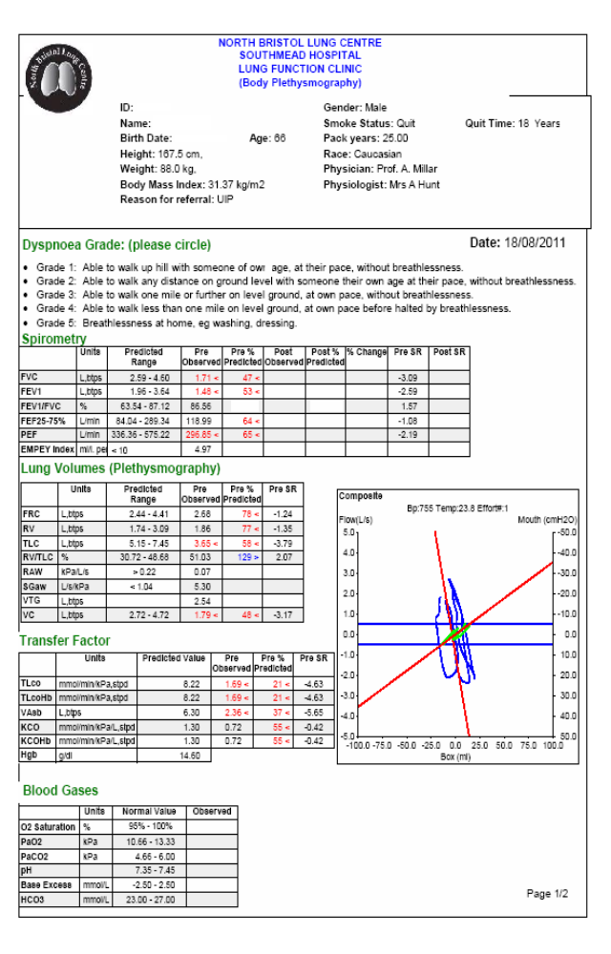
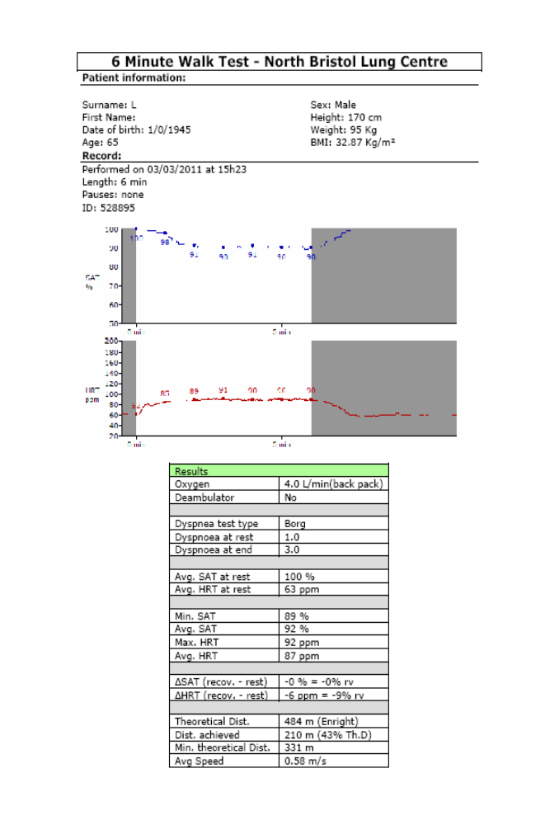
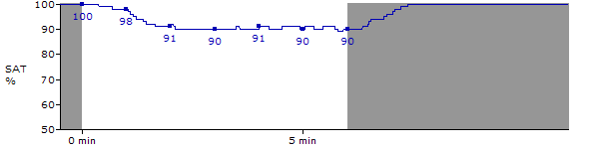
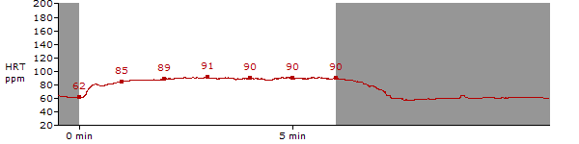
Notes:
Pts will have full pfts and 6 mwt at each clinic review as an objective assessment – if gas transfer reduced – perform an abg on air.

Slide 7
Oxygen therapy
Oxygen may improve symptoms and QOL but pts may be reluctant to use ambulatory oxygen in the early stages
As disease progresses breathlessness / hypoxia becomes a major problem. Can reduce exercise performance significantly - therefore oxygen is a crucial part of care
Oxygen therapy is the single most important supportive treatment we can offer patients with progressive ILD, helps to maintain a near-normal quality of life. Can double exercise performance.
pO2 < 7.3 or below 8kPa with clinical evidence of PH and who are SOB should be considered for palliative oxygen. These individuals may also benefit from an ambulatory supply.
34 pts IPF/NSIP ambulatory oxygen improved 6MWD from baseline (Visca et al 2011)
70 IPF pts, oxygen naïve pts improved walking distance by 80m, those optimised on ambulatory oxygen improved by 16.9m (Hicks et al 2007)
Exceptional healthcare, personally delivered
Notes:
Oxygen therapy is a particularly important intervention. Patients will typically require ambulatory oxygen before long term oxygen therapy.

Slide 8
Ambulatory oxygen
Pts generally experience exertional breathlessness associated with hypoxia and are likely to require ambulatory oxygen before LTOT
Assessment : 6 MWT to assess walking distance, BORG
Desaturation of >4% to a value of < 90%
Titrate O2 to correct exercise desaturation where possible
May be reluctant to be seen in public with oxygen, pace activity
Signifies disease progression
However, can significantly improve QOL and exercise tolerance
Often require double rate required at rest, freeflow setting
Assess best mode of delivery
Consider how long O2 supply will last – may require 2 units
Exceptional healthcare, personally delivered
Notes:
Resting sats are not a good indicator of oxygen desaturation on exercise, and the 6 mwt is essential as some pts will significantly desaturate, in particular those with IPF May not stop desaturation but will raise the baseline oxygen level and enable faster recovery rate, improving exercise performance
Many pts will have a threshold for using ambulatory oxygen – and may prefer to pace activity in the first instance
The greater the exertion, the greater the fall in saturation so pacing activity is vital
Anxiety about running out

Slide 9
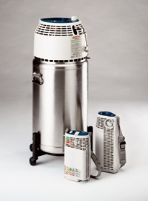
Liquid Oxygen
-183°C (1l LOX warms up to 860l gas)
1 dewar = 35,000 l of O2 as gas (70 cyl)
Fill unit 30 mins before going out
Helios: variable flow 1-6 l/min, lasts 1.9 hours at 6 l/min constant
Companion: 0.25 l/min – 15 l/min. Lasts 8 hours at 2 l/min or 2.9 hrs at 6l/min constant
May require 2 units
Will evaporate if unused
Exceptional healthcare, personally delivered

Slide 10
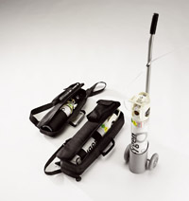
Portable cylinders
430 l cylinder
At 4l/min lasts around 1 hour 45 mins
Carry bag or trolley available
Exceptional healthcare, personally delivered

Slide 11
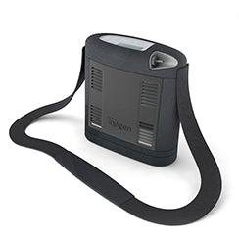
Portable oxygen concentrators
Not the solution for everyone but can be useful in carefully
selected patients
Help to keep active
May use on planes but check battery life
However….. limitations
Pulsed dose only
Exceptional healthcare, personally delivered

Slide 12
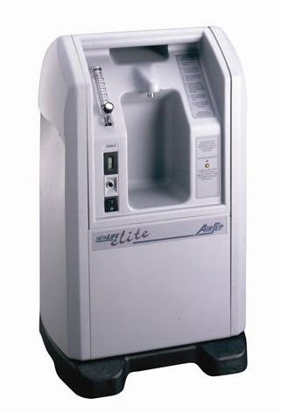
Concentrators
0-2 l/min and 1-5 l/min, Elite
2-8 l/min Intensity
Room air passes through sieve bed of zeolite crystals removing nitrogen and CO2
Piggy back for higher flow rates
Serviced and electric costs re-imbursed
Humidification not necessary at low flow
Can use around the home as LTOT and ambulatory supply
Exceptional healthcare, personally delivered

Slide 13



Holiday/travel advice
Discuss with HCP, fit to fly?
Oxygen in UK and abroad – NHS choices website,DOH, charges for abroad
DWP for EU re-imbursement if receipts kept
Request assistance
Travel insurance essential should the individual become ill and need to return home. Check it covers all medical conditions
EHIC (European Health Insurance Card) entitles you to reduced /free medical treatment if you fall ill in Europe – not a replacement for insurance
Emergency treatment and repatriation can be costly !
BLF comprehensive travel pack
Exceptional healthcare, personally delivered
Notes:
Consider location, transport links, close to amenities
Think about facilities, steps, access, weather – too hot/cold – can I fly?

Slide 14
Points to remember
All pts should be under the care of a centre for oxygen assessment
Oxygen prescriptions individualised to patient requirements, different flow rates at rest and exertion, and exercise (PR)
Can be complex
Require ongoing monitoring and regular review
CISS database can be accessed by all the Respiratory Teams
Exceptional healthcare, personally delivered

Slide 15
When do you initiate palliative care?
“Would you be surprised if this patient were to die in
the next 6-12 months?”
• Early stage of the disease all the way through EOL
Frequent hospitalisations, infections, exacerbations
Increasing oxygen requirements
Episodes of panic
Increasing breathlessness and reduced mobility
Hypoxic episodes
“do you know how you would like things to be if this should get any worse?
“have you any concerns, fears or worries for the future”
“have you thought about where you would prefer to be cared for as your illness gets worse?”
Exceptional healthcare, personally delivered
Notes:
We are fortunate to have the support of st peters hospice to advise on symptom control
FAB course

Slide 16
Always better to start early
IPF in particular is unpredictable
Patients can deteriorate rapidly
Recognise those patients reporting increased SOB
Beware of patients who start to panic who otherwise have been coping well
Exceptional healthcare, personally delivered

Slide 17
Breathlessness…… Why?
On exertion, consider assessment for cause of SOB and degree of hypoxia
Breathless at rest – assess cause of SOB and degree of hypoxia
Assess for ambulatory oxygen / LTOT
Psychosocial needs and offer referral to palliative care services
Pharmacological symptom relief with benzodiazepines and /or opioids
BUT always remember differential diagnosis!
PH, PE, infection (pts on immunosuppressive Rx) etc
IPF Clinical Guideline 2013
Exceptional healthcare, personally delivered
Notes:
Always consider cause for SOB -- Differential diagnosis – cough – GORD, post nasal drip, PE, PH
Frequent infections in those on immunosuppressive therapy

Slide 18
Respiratory failure
Often require high flow humidified oxygen on ward
As condition allows reduce flow and assess oxygen requirements with concentrator/s
Can piggy back, cold humidification?
High flow nasal cannula alternating with face mask
Increase flow rate when transferring /exertion – cylinder
Physiotherapist expertise
Use of fan, optimisation of symptom control, Palliative care team
Liaise with all HCP’s, primary / secondary care
Consider patient / family wishes – is home a viable option? i.e is sufficient care available in home surroundings, is safe transfer home possible? Feel safe
Exceptional healthcare, personally delivered
Notes:
Pts may be admitted with resp failure and require high flow humid oxygen.
Venturi barrels for masks – 28% white 4 l, 35% yellow 8l, 40% red 10 l, 60% green 15l/min
Med conc face mask – 35-60% oxygen depending upon flow and breathing rate of pt
Try on ward for comfort although pts might initially want to die at home, with inc o2 needs and sob, being in hospital a good option – feel safe

Slide 19
Transplantation
Many pts are older, may have co-morbidities, so rarely an option
Timely referral for assessment
Lack of organs , 3 people die every day waiting for a transplant
Talk about it-
Let your family, and friends know your wishes about organ donation
Exceptional healthcare, personally delivered
Notes:
When considering transplantation – many pts are older, can have co-morbidities, so rarely an option
Early referral is advisable

Slide 20
Our Support Group
Provides an opportunity to meet and talk to others - to share stories and experiences with others who understand what they are going through
Exchange ideas, mutual support
“not feeling alone”
Encourage involvement in pleasurable activities
Invest in friends and family, be positive!
Speaker, refreshments, provide accurate information
Exceptional healthcare, personally delivered
Notes:
Started our group feb 2013, and meet 2 monthly

Slide 21

Charities
Pulmonary Fibrosis Trust
Offer grants, information and support, raise awareness
www.pulmonaryfibrosis.uk
Action for Pulmonary Fibrosis UK
www.actionpulmonaryfibrosis.org
Raise awareness, patient and family education and support and promoting research. Aims to set up regional support groups , currently only 7 in the UK
Pulmonary Fibrosis Foundation
www.pulmonaryfibrosis.org for information & resources, webinars
British Lung Foundation Irish Lung Fibrosis Association
www.blf.org.uk ilfa.ie
Exceptional healthcare, personally delivered

Slide 22
References
Adamali HI, Anwar MS, Russell AM, Egan JJ Non-pharmacological treatment of idiopathic pulmonary fibrosis.
Current Respiratory Care Reports. 2012 (4): 208-215
Bajwah S, Koffman J, Higginson J et al. “ I wish I knew more” the end of life planning and information needs for end-stage fibrotic interstitial lung disease: views of patients, carers and health professionals BMJ Support Palliat Care Sept 27th 2012 doi: 10.1136/bmjspcare-2012-000263
Bajwah S, Ross J, peacock J et al. Interventions to improve symptoms and quality of life of patients witrh fibrotic interstitial lung disease: a systematic review of the literature Thorax 2102 doi: 10.1136/thoraxjnl-2012-202040
Bradley B, Branley HM, Egan JJ, Greaves MS, Hansell DM, Harrison NK et al. Interstitial lung disease guideline: the British Thoracic Society in collaboration with the Thoracic Society of Australia and New Zealand and the Irish Thoracic Society. Thorax. 2008; 63 Suppl 5:v1-58. (Guideline Ref ID BTS2008)
British Thoracic Society. Clinical component for the home oxygen service in England and Wales, 2006 Available from: http://www.brit- thoracic.org.uk/Portals/0/Clinical%20Information/Home%20Oxygen%20Service/clinical%20adultoxygenjan06.pdf (Guideline Ref ID BTS2006)
Raghu G, Collard HR, Egan JJ, et al. ATS/ERS/JRS/ALAT Committee on Idiopathic Pulmonary Fibrosis. An official ATS/ERS/JRS/ALAT statement: idiopathic pulmonary fibrosis: evidence-based guidelines for diagnosis and management. Am J Respir Crit Care Med. 2011;183(6):788-824
Travis W, Costabel U, Hansell D et al. An Official American Thoracic Society/European Respiratory Society Statement: Update of the International Multidisciplinary Classification of the Idiopathic Interstitial Pneumonias. Am J Respir Crit Care Med 2013: Vol 188 (6) 733–748
Exceptional healthcare, personally delivered

Slide 23
Any questions?
Exceptional healthcare, personally delivered

