Slide 1
Tuberculosis in the South West
Annual Review 2017: a summary
Rachel Kwiatkowska, ST4 Public Health Academic Clinical Fellow
Field Epidemiology Service, National Infection Service, Public Health England

Slide 2
Overview
TB surveillance
Epidemiology of TB in the South West
      Recent trends
      Areas of high disease burden
      At-risk populations
      Benchmarking the South West
Public health messages

Slide 3
TB surveillance England & Wales
1993 – TB resurgence, WHO declares ‘global emergency’
1999 - Enhanced TB surveillance established E&W
2008 - Enhanced Tuberculosis Surveillance (ETS) system
Secure website, real-time case notification/ de-notification
Users can:
      Monitor treatment outcomes
      Generate reports
      Export case or lab information

Slide 4
TB epidemiology in the South West 2016
239 cases of TB notified: rate 4.33 per 100k population
UK-born children < 15 years notification rate very low: 0.1 per 100k population
Majority of cases pulmonary TB (65%); 25% of these also with non-pulmonary TB disease
Median time symptom onset to diagnosis for pulmonary disease: 89.0 days (IQR: 45.0 to 164.0)
Treatment completion at 12 months*: 185 cases (76%)
Culture-confirmed cases resistant to ≥1 first-line drug: 12.1%
*excluding CNS disease and drug resistant TB

Slide 5
Trends
Number of TB cases, rate and 95% confidence intervals, South West and England, 2000-2016

Slide 6
Trends
Third year-on-year reduction in TB rate
Increased length of time between entry to the UK and TB diagnosis for non-UK born cases (median 8 yrs in 2016)
Increase in number of cases occurring in those with ≥1 social risk factors (15% in 2016; highest rate since 2009)
Increase in proportion of drug-resistant cases
Increase in cases experiencing delays greater than 4 months from symptom onset to treatment start: 38% pulmonary cases had a delay over four months

Slide 7
Trends – non-UK born cases
Time between entry to the UK and TB diagnosis for non-UK born cases by year, South West, 2000-2016

Slide 8
Trends – drug resistance
Proportion of TB cases with first-line drug resistance, South West, 2000 to 2016

Slide 9
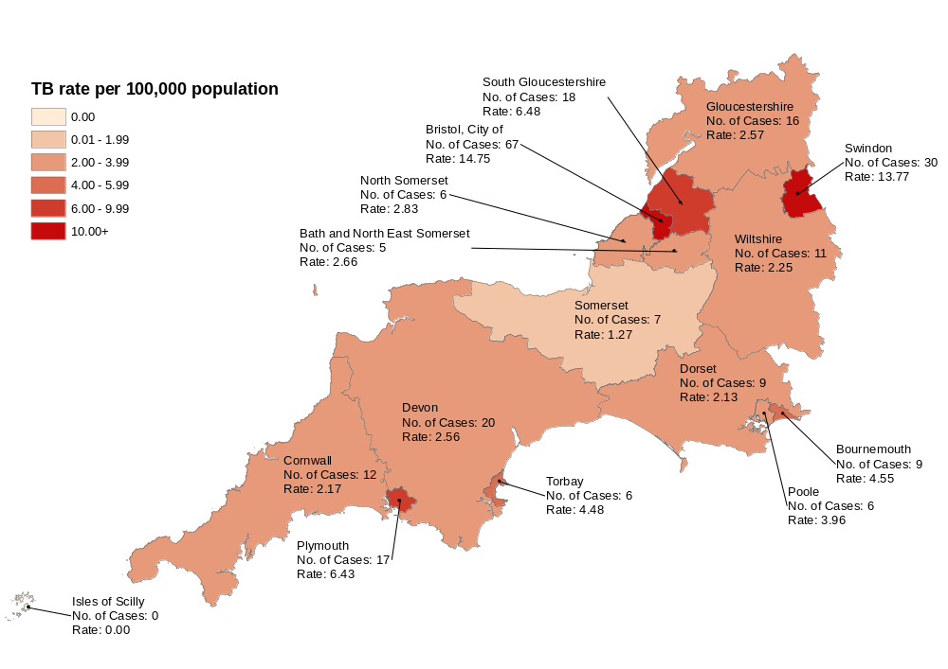
Areas of high disease burden
TB rate per 100,000 population by upper tier local authority of residence, South West, 2016

Slide 10
At-risk populations
Case rate in the UK born population 1.9 / 100k and
Case rate in the non-UK born population 31.2 / 100k
White ethnic groups represent the largest proportion (48%)
Significant proportion with ≥ 1 social risk factor (15%)
Data indicate that cases with social risk factors more likely to have drug-resistant infection
Groups without social risk factors experiencing longer delays between symptom onset and treatment

Slide 11
At-risk populations: Age
TB rate by age group, South West, 2000-2016

Slide 12
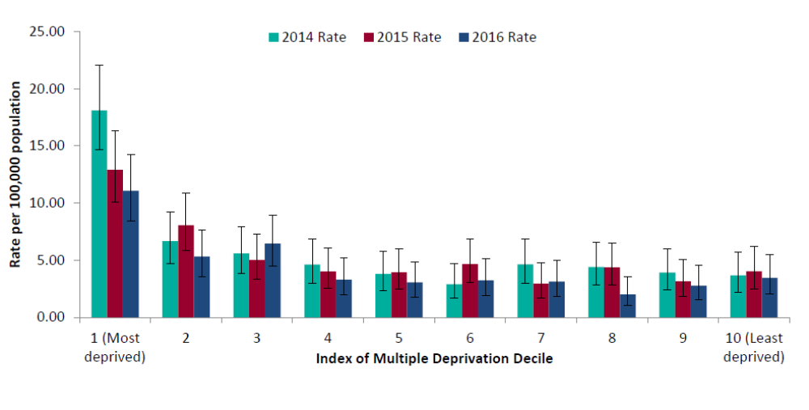
At-risk populations: IMD
TB case rate and 95% confidence intervals by Index of Multiple Deprivation decile, South West, 2000 to 2016

Slide 13
Benchmarking the South West
TB rate less than half national rate: 4.3 vs 10.2 per 100k
Lowest regional rate of TB in England
Third highest proportion of cases reporting ≥ 1 social risk factor (15.0%)
Highest proportion of cases reporting homelessness
Lowest regional culture confirmation rate in England: 62% (69% of pulmonary; 52% of non-pulmonary cases)
Lower than national average rate of HIV testing (90.2% vs 93.2%)
Lower than national average proportion of cases receiving DOT (8.1% vs 14.3%)

Slide 14
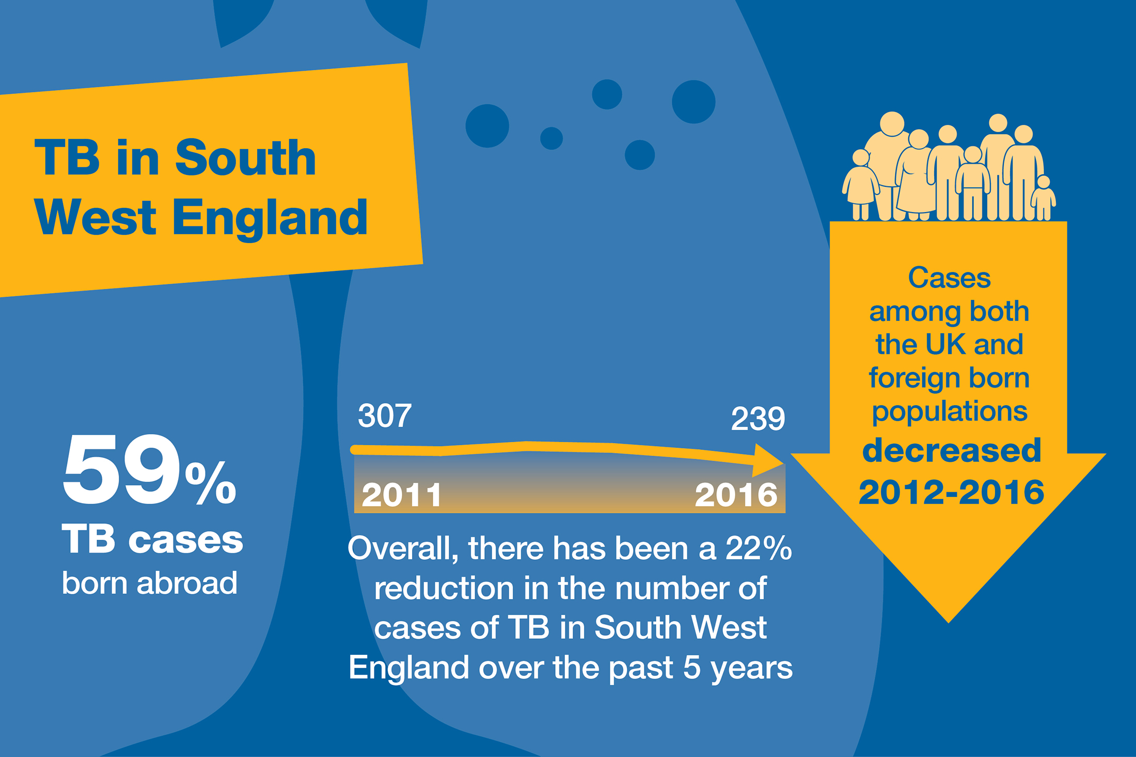
Public Health messages

Slide 15
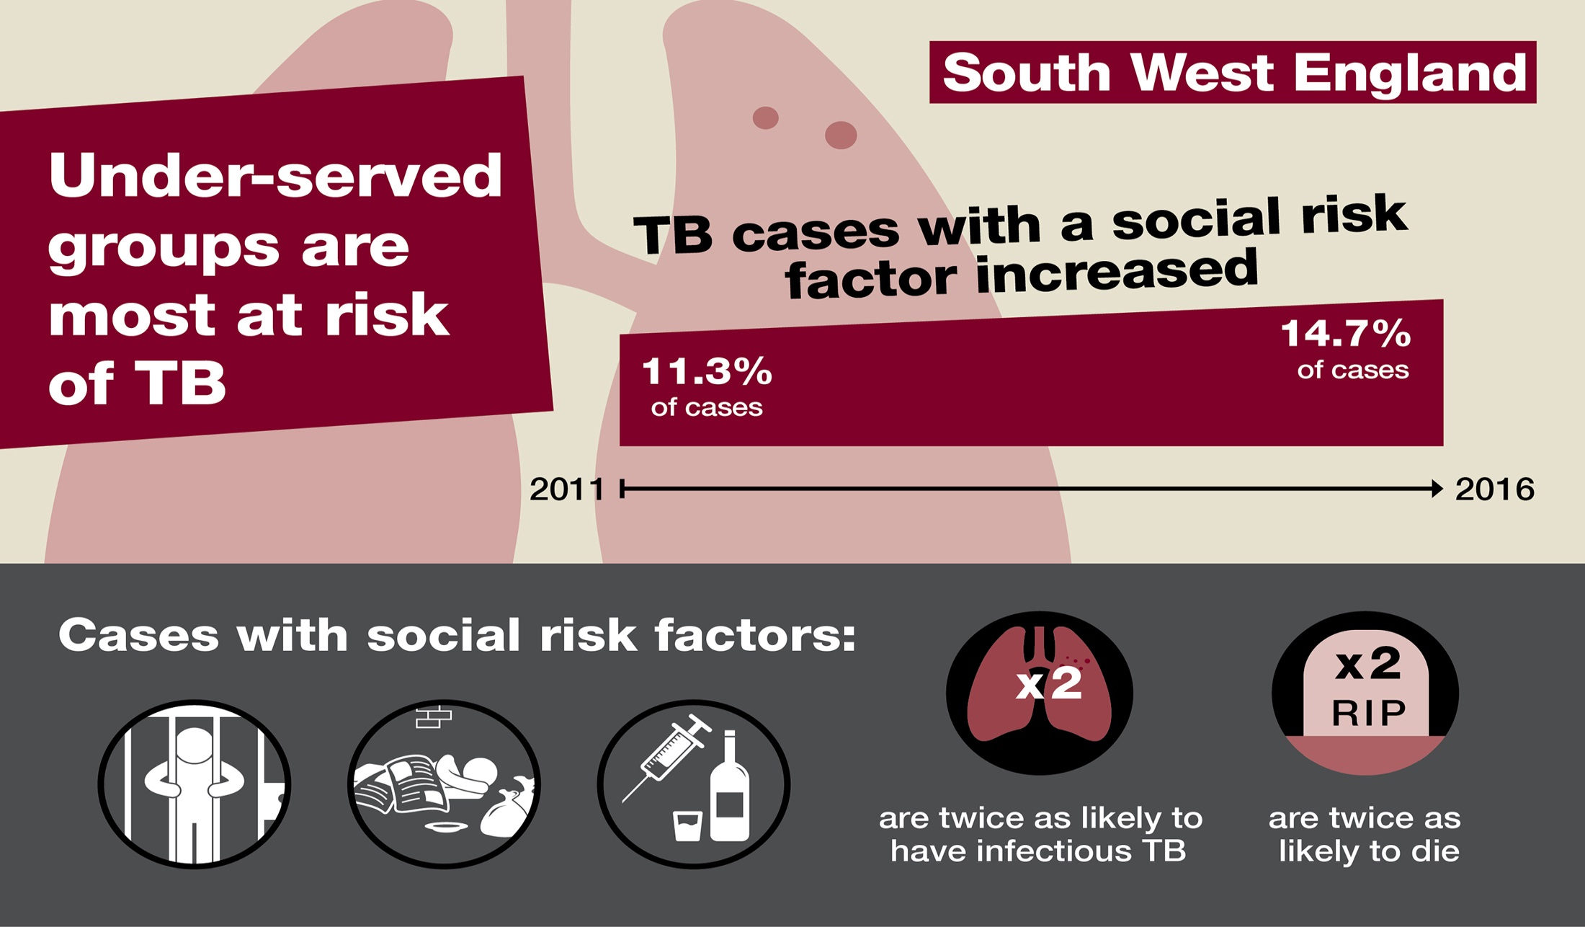
Public Health messages

Slide 16
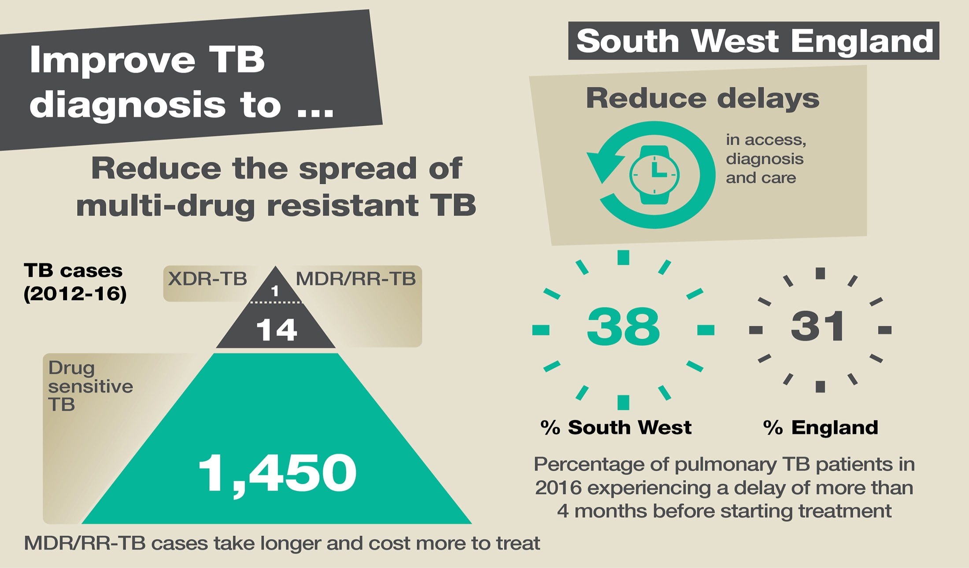
Public Health messages

Slide 17
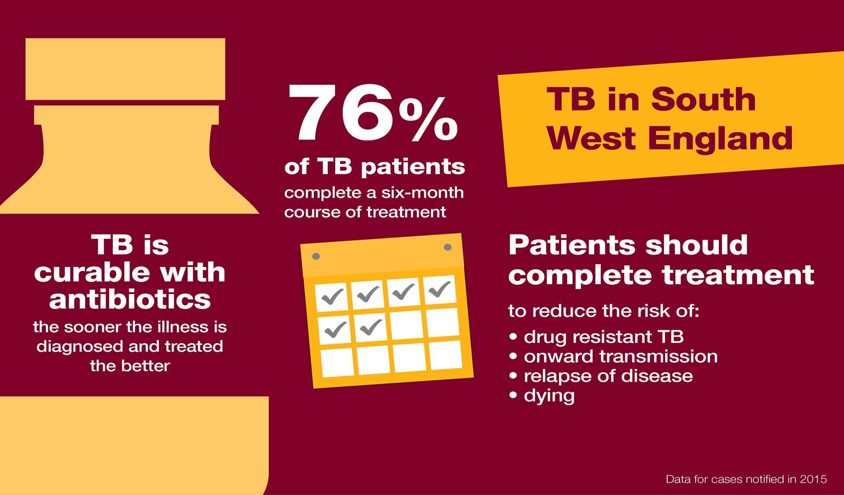
Public Health messages

Slide 18
Useful links
South West TB Annual Report:
https://www.gov.uk/government/uploads/system/uploads/attachment_data/file/673082/Tuberculosis_in_the_South_West_Annual_Review.pdf
Public Health Matters blog: reducing the burden of TB
https://publichealthmatters.blog.gov.uk/2016/10/20/health-matters-reducing-the-burden-of-tuberculosis/
PHE Fingertips tool: Health Protection profiles
https://fingertips.phe.org.uk/profile/health-protection

Slide 19
Summary points
Increase in proportion of cases experiencing delays >4 months from symptom onset to treatment start (38%)
Increased length of time since entry to the UK to TB diagnosis for non-UK born cases
Increase in the proportion of cases reporting ≥ 1 social risk factor (15%)
Low rates of culture confirmation (62%)
Higher rates of TB in areas with the most socio-economic deprivation
Increased drug resistance

